Slide 1

Tech-mining of
Advanced Technologies
Detecting world leaders through tech-mining
By Stig Yding Sørensen, Senior Specialist
Danish Technological Institute
Centre for Policy and Business Analysis

Slide 2
Advanced technologies
ICT
Artificial Intelligence, machine learning, and neural networks
Wireless communication
Virtual/augmented reality
Cyber security
Materials, production, and nano-tech
Automation and robotics
Additive manufacturing/3D-print
Drones and satellites
Nano-tech
Optical tech
Sensors
Photonics
Hint
In presentation mode
Click on the dot to
return to this
menu-page

Slide 3
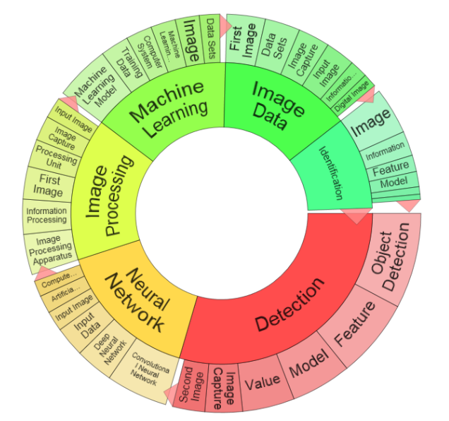
Artificial Intelligence, Machine Learning Neural Networks
ICT
CPC:(G05B2219/00 OR G05B13/02 OR G01S7/417 OR G05B13/027 OR G05B13/028 OR G05B13/0275 OR G05B13/026 OR G05B13/0265 OR G05B13/0285 OR G05B13/029 OR G05B13/0295 OR G05B2219/25255 OR G05B2219/32335 OR G05B2219/33013 OR G05B2219/33014 OR G05B2219/33015 OR G05B2219/33021 OR G05B2219/33024 OR G05B2219/33025 OR G05B2219/33026 OR G05B2219/33027 OR G05B2219/33029 OR G05B2219/33035 OR G05B2219/33041 OR G05B2219/33044 OR G05B2219/34066 OR G05B2219/34081 OR G05B2219/39271 OR G05B2219/39286 OR G05B2219/39311 OR G05B2219/39312 OR G05B2219/40494 OR G05B2219/40529 OR G05B2219/41054 OR G05B23/024 OR G05B23/0254 OR G05B23/0281 OR G06F11/1476 OR G06F11/2263 OR G06F19/345 OR G06F2207/4824 OR G06J OR G06K7/1482 OR G06N3/008 OR G06N3/02 OR G06N3/06 OR G06N7/046 OR G06N99/005 OR G06T2207/20084 OR G06T3/4046 OR G06T9/002 OR G08B29/186 OR G10H2210/031 OR G10H2250/311 OR G10K2210/3038 OR G10L15/16 OR G10L17/18 OR G10L25/30 OR G11B20/10518 OR H01J2237/30427 OR H01M8/04992 OR H02H1/0092 OR H02P21/0014 OR H02P23/0018 OR H03H2017/0208 OR H03H2222/04 OR H04L2012/5686 OR H04L2025/03464 OR H04L2025/03554 OR H04L25/0254 OR H04L25/03165 OR H04L45/08 OR H04N21/4666 OR H04Q2213/054 OR H04Q2213/13343 OR H04Q2213/343 OR H04R25/507 OR Y10S128/925 OR G01R31/3651 OR G01N33/0034 OR G01N2201/1296 OR F16H2061/0084 OR F05D2270/709 OR F05B2270/709 OR F03D7/046 OR F02D41/1405 OR E21B2041/0028 OR B64G2001/247 OR B60G2600/1878 OR B29C66/965 OR B29C2945/76979 OR B25J9/161 OR B23K31/006 OR A61B5/7264) AND IPC:(H01M8/04992) OR IPC:(G06N3/02 OR G06N3/06 OR G06T1/40 OR G10L15/16 OR G10L17/18 OR G10L25/30 OR H01M8/04992) or [SEMANTIC]20d1b092-9fb6-48d6-9e68-6874bbdf3165 OR CPC:(G06F19/24 OR G06F19/707 OR G06K9/62 OR G06N99/005 OR G06F15/18) OR IPC:(G06F19/24 OR G06F15/18) NOT PN:(CN)
Global patents: 53,776 patent families
European patents: 2,438
Danish patents: 38

Slide 4
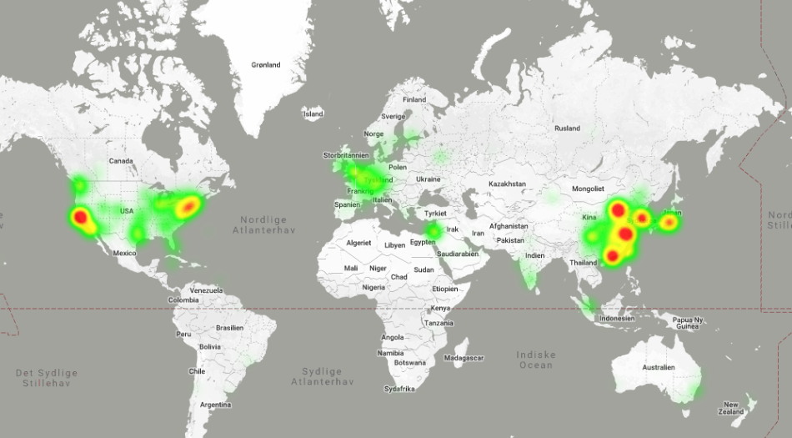
Artificial Intelligence 2017–2018, based on 10,000 patents

Slide 5
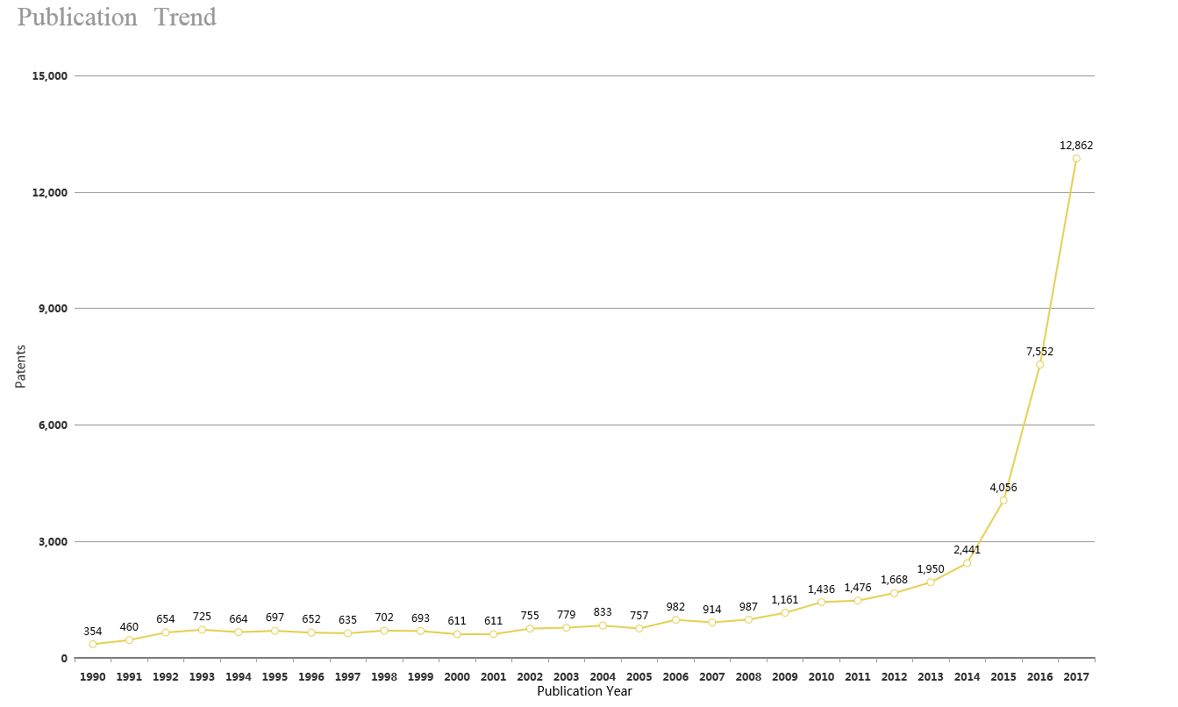
Publication trend 1990–2017
Artificial Intelligence

Slide 6
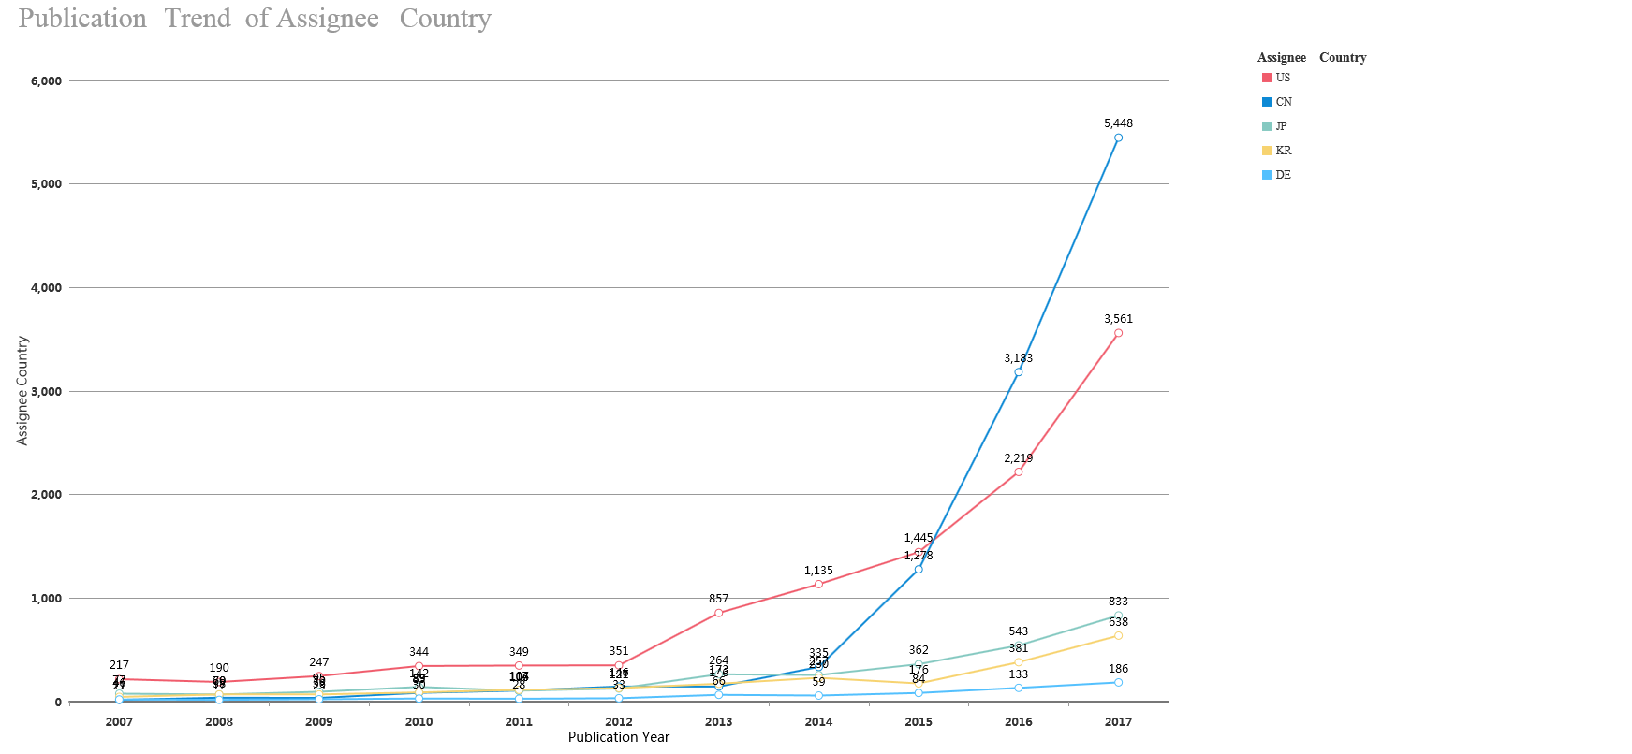
Publication trend of main countries - 10 years
Artificial Intelligence

Slide 7
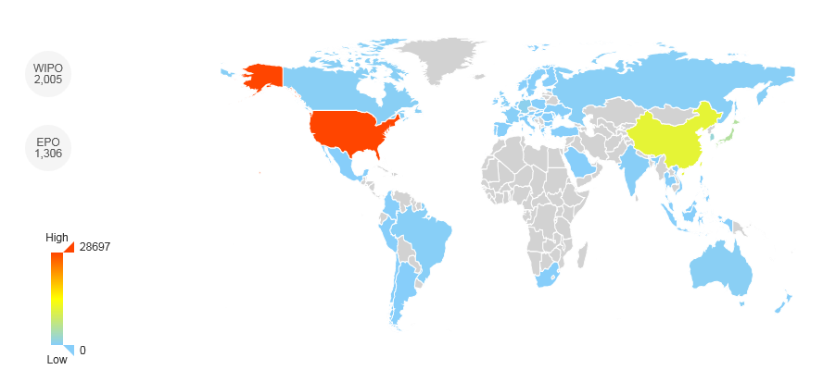

Artificial Intelligence

Slide 8
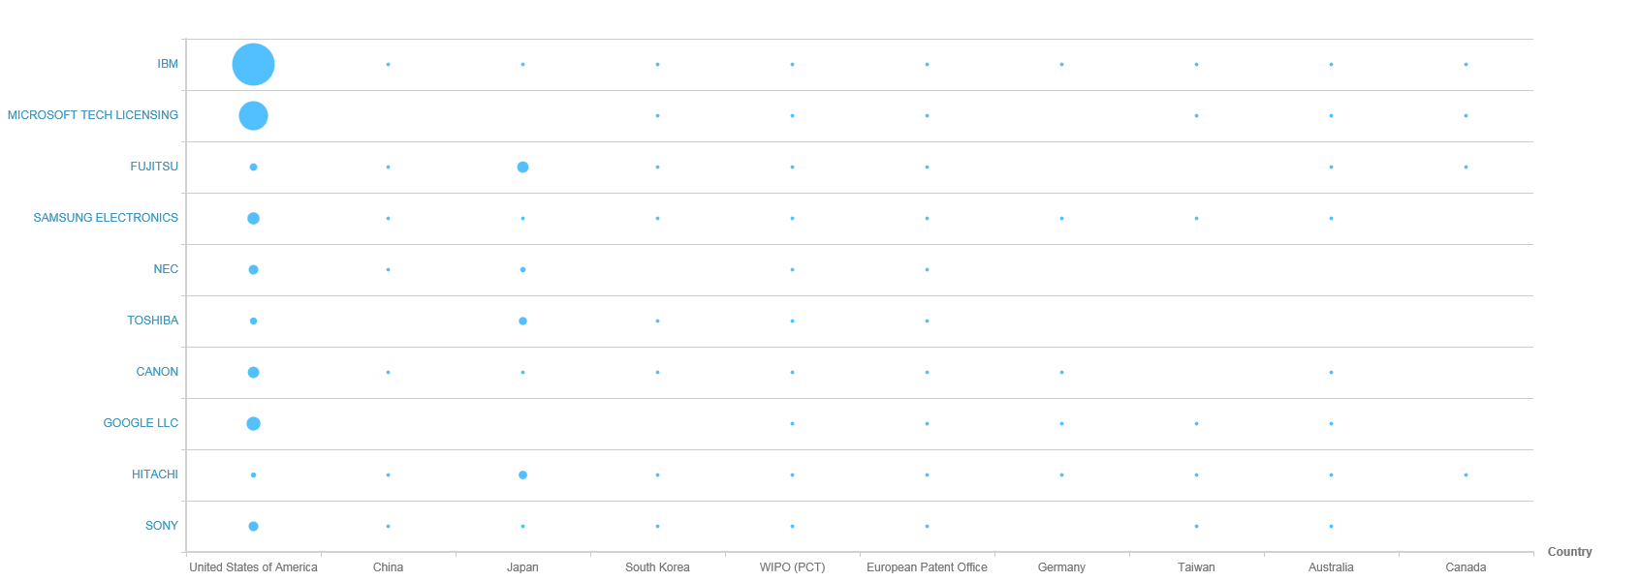
Global leaders
The graph shows the number of patents that the top organisations in the technology field hold in the top 10 jurisdictions in the world
Helpful for determining which geographical markets the top organisations in the technology field are focusing on and looking to commercialise their products in. This indicates the most successful global markets the technology has penetrated.
Artificial Intelligence

Slide 9
Top 10 global players
Indicators Profile | IBM | MICROSOFT TECH LICENSING | FUJITSU | SAMSUNG ELECTRONICS | NEC | TOSHIBA | CANON | GOOGLE LLC | HITACHI | SONY
Annual Sales | $ 79,139m | - | $ 41,580m | $ 174,121m | $ 24,572m | $ 44,909m | $ 31,362m | - | $ 84,478m | -
Portfolio Size | 1,863 | 1,231 | 827 | 709 | 667 | 676 | 635 | 650 | 606 | 565
Employee Number | 414,400 | - | 155,069 | 93,200 | 107,729 | 153,492 | 197,673 | - | 303,887 | -
Market Cap | $ 156,874m | - | $ 11,137m | $ 148,466m | $ 5,870m | $ 7,918m | $ 21,834m | - | $ 25,119m | -
Portfolio Value | $ 443m | $ 451m | $ 112m | $ 97m | $ 138m | $ 90m | $ 231m | $ 335m | $ 41m | $ 286m
R&D Expense | $ 5,226m | - | $ 181m | $ 6,371m | $ 2,650m | $ 3,240m | - | - | $ 3,268m | -
R&D Expense % | 6.60% | - | 0.44% | 3.66% | 10.79% | 7.22% | - | - | 3.87% | -
Artificial Intelligence

Slide 10
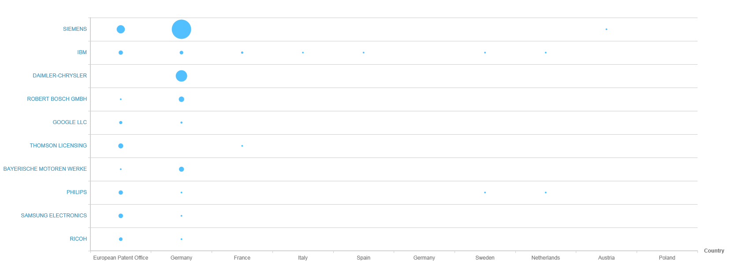
European leaders: Activity
The graph shows the number of patents held by the top organisations in the technology field within the top 10 jurisdictions in Europe
Helpful for determining which geographical markets the top organisations in the technology field are focusing on and looking to commercialise their products in. This indicates the most successful global markets the technology has penetrated.
Artificial Intelligence

Slide 11
Top 10 European players
Indicators Profile | SIEMENS | IBM | DAIMLER-CHRYSLER | ROBERT BOSCH GMBH | GOOGLE LLC | THOMSON LICENSING | BAYERISCHE MOTOREN WERKE | PHILIPS | SAMSUNG ELECTRONICS | RICOH
Annual Sales | - | $ 79,130m | $ 169,586m | - | - | - | $ 104,193m | - | $ 174,121m | $ 18,706m
Portfolio Size | 156 | 65 | 53 | 30 | 26 | 26 | 23 | 70 | 22 | 18
Employee Number | - | 414,400 | 282,488 | - | - | - | 124,729 | - | 93,200 | 105,613
Market Cap | - | $ 156,875m | $ 81,143m | - | - | - | $ 36,872m | - | $ 148,466m | $ 5,027m
Portfolio Value | $ 6,305,000 | $ 4,260,000 | $ 520,000 | $ 1,890,000 | $ 820,000 | $ 480,000 | $ 160,000 | $ 9,150,000 | $ 1,190,000 | $ 2,040,000
R&D Expense | - | $ 5,226m | $ 4,618m | - | - | - | $ 6,486m | - | $ 6,371m | $ 824m
R&D Expense % | - | 6.60% | 2.72% | - | - | - | 6.23% | - | 3.66% | 4.41%
Artificial Intelligence

Slide 12
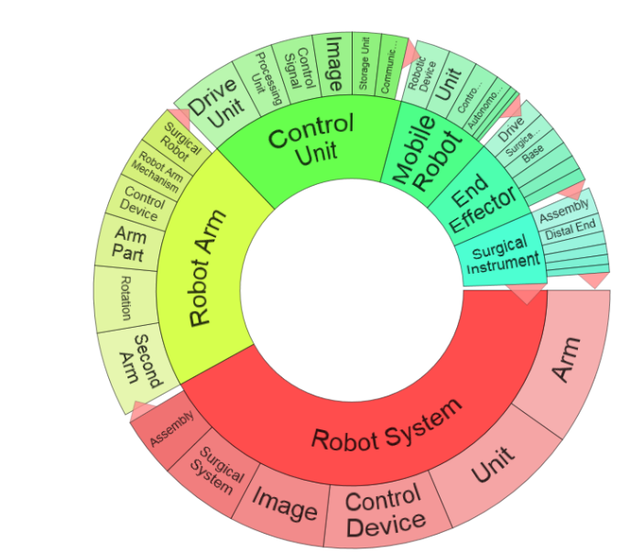
Automation and Robotics
Materials, production, and nano-tech:
IPC:(B29C70/38 OR A63F13/803 OR A61B34/37 OR A61B34/30) or CPC:(A22B5/0041 OR A01D46/30 OR A47L2201/00 OR A47L9/2873 OR A61B2034/305 OR A61B34/30 OR A61B34/37 OR A61H2201/1659 OR A61F2002/704 OR A61M25/0116 OR A61N5/1083 OR A63F13/803 OR A63H33/003 OR B01J2219/00691 OR B05B13/0431 OR B07C2501/0063 OR B07C OR B25J11/0015 OR B25J13/089 OR B25J19/0029 OR B25J9/0003 OR B25J9/065 OR B25J9/1035 OR B29C2045/4216 OR B29C2045/4266 OR B29C2045/4275 OR B29C2045/4283 OR B29C2045/4291 OR B29C2945/76317 OR B29C2945/76795 OR B29C37/0007 OR B29C66/863 OR B32B2038/1891 OR B60C25/0515 OR B64G2001/247 OR B64G2004/005 OR B65F2230/14 OR B65H2555/31 OR B67D2007/0403 OR F16C2322/59 OR F16H2057/0043 OR F16H2061/0071 OR F24F2221/42 OR F41H7/005 OR G01N35/0099 OR G01S13/881 OR G05B2219/00 OR G05B2219/2661 OR G05B2219/31008 OR G05B2219/31028 OR G05B2219/31076 OR G05B2219/31077 OR G05B2219/31078 OR G05B2219/31081 OR G05B2219/31305 OR G05B2219/31371 OR G05B2219/32278 OR G05B2219/32386 OR G05B2219/33097 OR G05B2219/33259 OR G05B2219/34277 OR G05B2219/34348 OR G05B2219/34456 OR G05B2219/35144 OR G05B2219/36017 OR G05B2219/36411 OR G05B2219/36427 OR G05B2219/36459 OR G05B2219/36475 OR G05B2219/36517 OR G05B2219/37021 OR G05B2219/37605 OR G05B2219/39001 OR G05B2219/39 OR G05B2219/39031 OR G05B2219/39042 OR G05B2219/39043 OR G05B2219/39046 OR G05B2219/39047 OR G05B2219/39048 OR G05B2219/39053 OR G05B2219/39059 OR G05B2219/39083 OR G05B2219/39094 OR G05B2219/39096 OR G05B2219/39132 OR G05B2219/39138 OR G05B2219/39143 OR G05B2219/39144 OR G05B2219/39146 OR G05B2219/39151 OR G05B2219/39154 OR G05B2219/39162 OR G05B2219/39163 OR G05B2219/39164 OR G05B2219/39165 OR G05B2219/39166 OR G05B2219/39168 OR G05B2219/39184 OR G05B2219/39208 OR G05B2219/39229 OR G05B2219/39233 OR G05B2219/39254 OR G05B2219/39259 OR G05B2219/39263 OR G05B2219/39369 OR G05B2219/39371 OR G05B2219/39384 OR G05B2219/39397 OR G05B2219/39402 OR G05B2219/39412 OR G05B2219/39413 OR G05B2219/39427 OR G05B2219/39428 OR G05B2219/39432 OR G05B2219/39433 OR G05B2219/39444 OR G05B2219/39445 OR G05B2219/39448 OR G05B2219/39451 OR G05B2219/39518 OR G05B2219/39567 OR G05B2219/40 OR G05B2219/40002 OR G05B2219/40039 OR G05B2219/40041 OR G05B2219/40042 OR B29C64/379 OR B29C70/38 OR G05B2219/40048 OR G05B2219/40083 OR G05B2219/40089 OR G05B2219/40099 OR G05B2219/40153 OR G05B2219/40165 OR G05B2219/40171 OR G05B2219/40173 OR G05B2219/40174 OR G05B2219/40196 OR G05B2219/40202 OR G05B2219/40216 OR G05B2219/40221 OR G05B2219/40224 OR G05B2219/40225 OR G05B2219/40227 OR G05B2219/40233 OR G05B2219/40234 OR G05B2219/40235 OR G05B2219/40238 OR G05B2219/40239 OR G05B2219/40241 OR G05B2219/40243 OR G05B2219/40251 OR G05B2219/40252 OR G05B2219/40253 OR G05B2219/40258 OR G05B2219/40264 OR G05B2219/40269 OR G05B2219/40276 OR G05B2219/40294 OR G05B2219/40301 OR G05B2219/40302 OR G05B2219/40305 OR G05B2219/40306 OR G05B2219/40307 OR G05B2219/40308 OR G05B2219/40316 OR G05B2219/40323 OR G05B2219/40353 OR G05B2219/40363 OR G05B2219/40364 OR G05B2219/40382 OR G05B2219/40388 OR G05B2219/40389 OR G05B2219/40391 OR G05B2219/40392 OR G05B2219/40394 OR G05B2219/40396 OR G05B2219/40397 OR G05B2219/40398 OR G05B2219/40409 OR G05B2219/40411 OR G05B2219/40413 OR G05B2219/40414 OR G05B2219/40415 OR G05B2219/40419 OR G05B2219/40434 OR G05B2219/40437 OR G05B2219/40449 OR G05B2219/40451 OR G05B2219/40478 OR G05B2219/40479 OR G05B2219/40494 OR G05B2219/40514 OR G05B2219/40522 OR G05B2219/40523 OR G05B2219/40528 OR G05B2219/40537 OR G05B2219/40582 OR G05B2219/40602 OR G05B2219/43119 OR G05B2219/45058 OR G05B2219/45059 OR G05B2219/45061 OR G05B2219/45062 OR G05B2219/45064 OR G05B2219/45065 OR G05B2219/45066 OR G05B2219/45068 OR G05B2219/45074 OR G05B2219/45079 OR G05B2219/45081 OR G05B2219/45082 OR G05B2219/45083 OR G05B2219/45084 OR G05B2219/45085 OR G05B2219/45086 OR G05B2219/45087 OR G05B2219/45088 OR G05B2219/45089 OR G05B2219/45091 OR G05B2219/45092 OR G05B2219/45093 OR G05B2219/45094 OR G05B2219/45097 OR G05B2219/45098 OR G05B2219/45099 OR G05B2219/45101 OR G05B2219/45104 OR G05B2219/45107 OR G05B2219/45108 OR G05B2219/45109 OR G05B2219/45113 OR G05B2219/45114 OR G05B2219/45115 OR G05B2219/45123 OR G05B2219/49195 OR G05B2219/50362 OR G05B2219/50363 OR G05B2219/50377 OR G05B2219/50391 OR G05D2201/0217 OR G06K9/00664 OR G06N3/008 OR G06T1/0014 OR H01H2231/04 OR H01L21/67742 OR H01L21/67766 OR H01L21/68707 OR H04N2201/0464 OR H04Q1/147 OR Y10S320/34 OR Y10S483/901 OR Y10S700/90 OR Y10S901/01 OR Y10S901/08 OR Y10T74/20305) or ABST:(robot*) NOT PN:(CN)
Global patents: 120,375 patent families
European patents: 19,328 patent families
Danish patents: 214 patent families

Slide 13
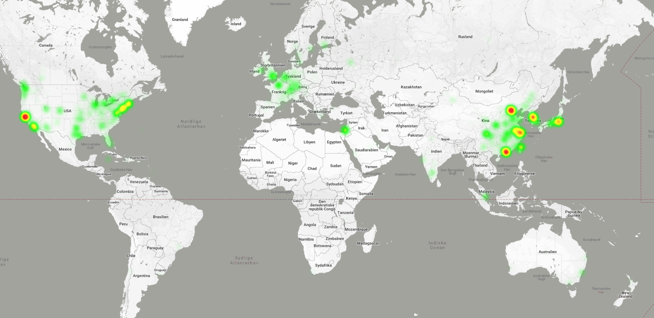
Automation and robotics 2017–2018, based on 10,000 patents

Slide 14
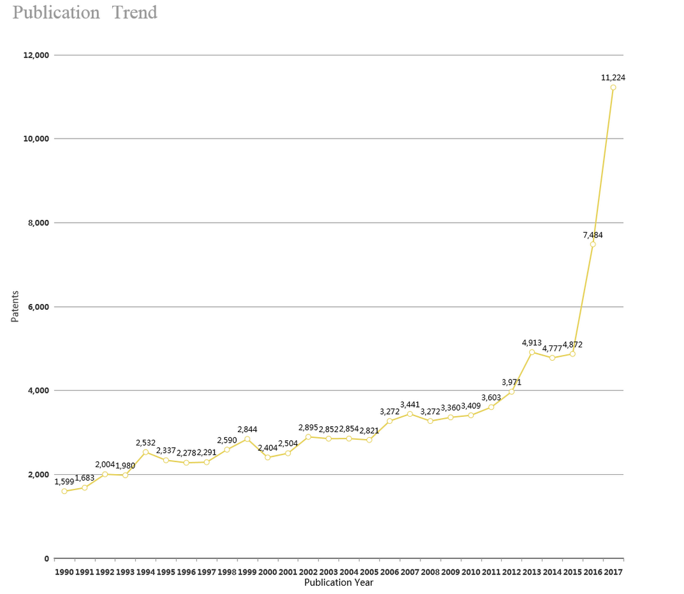
Publication trend 1990–2017
Automation and robotics

Slide 15
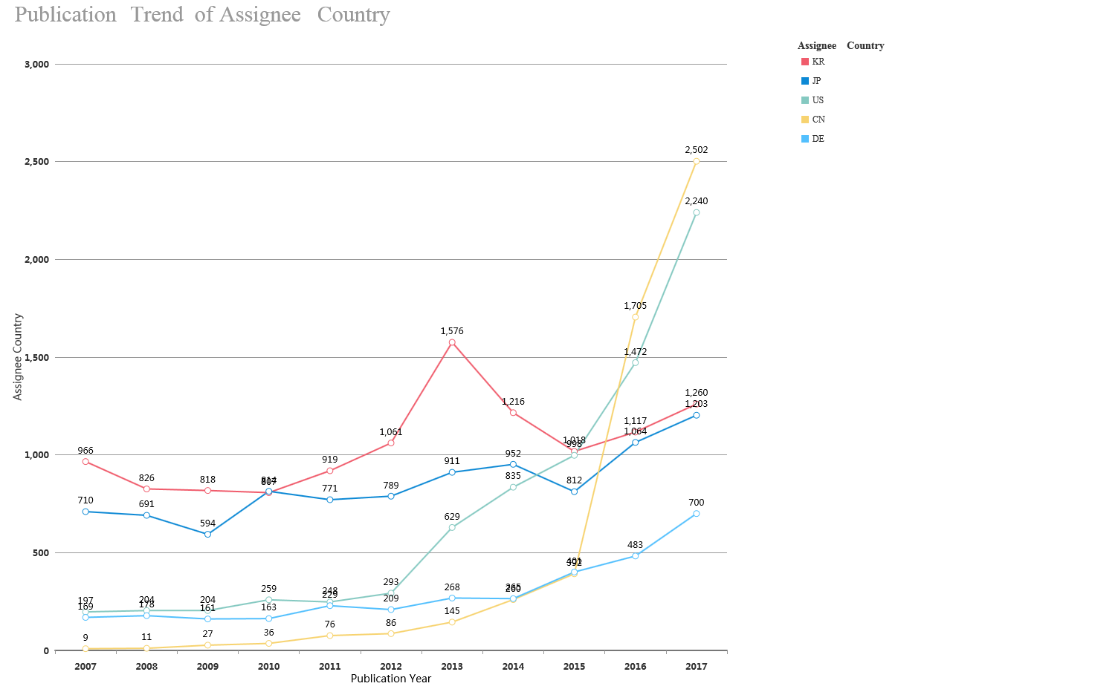
Publication trend of main countries - 10 years
Automation and robotics

Slide 16
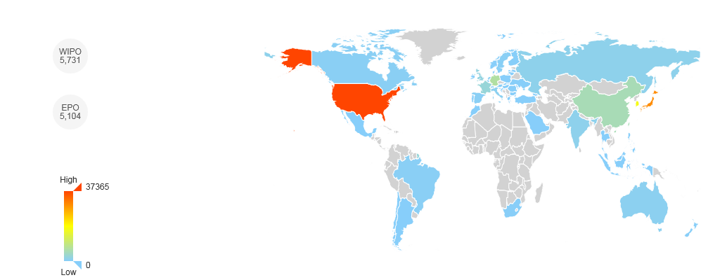

Automation and robotics

Slide 17
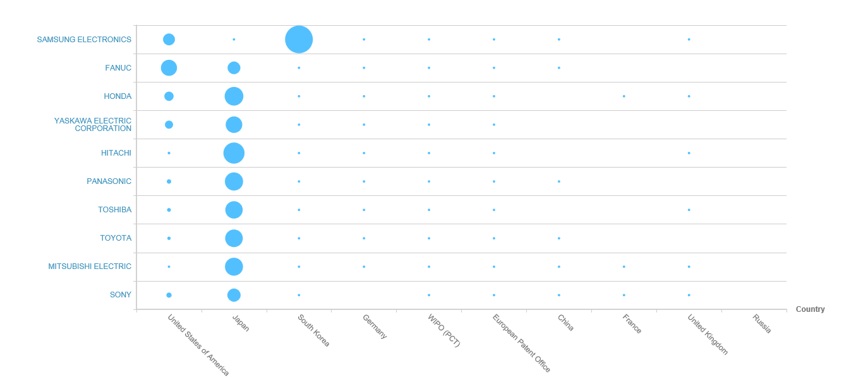
Global leaders
The graph shows the number of patents the top organisations in the technology field hold within the top 10 jurisdictions in the world
Helpful for determining which geographical markets the top organisations in the technology field are focusing on and looking to commercialise their products in. This indicates the most successful global markets the technology has penetrated.
Automation and robotics

Slide 18
Top 10 global players
Indicators Profile | SAMSUNG ELECTRONICS | FANUC | HONDA | YASKAWA ELECTRIC CORPORATION | HITACHI | PANASONIC | TOSHIBA | TOYOTA | MITSUBISHI ELECTRIC | SONY
Annual Sales | $ 174,121m | $ 4,950m | - | $ 3,640m | $ 84,478m | $ 67,710m | $ 44,909m | $ 254,678m | $ 39,081m | -
Portfolio Size | 2,378 | 1,853 | 1,702 | 1,629 | 1,449 | 1,370 | 1,289 | 1,241 | 1,216 | 1,161
Employee Number | 93,200 | 6,738 | - | 11,810 | 303,887 | 257,533 | 153,492 | 364,445 | 138,700 | -
R&D Expense | $ 6,371m | - | - | - | $ 3,268m | $ 4,046m | $ 3,240m | - | - | -
R&D Expense % | 3.66% | - | - | - | 3.87% | 5.98% | 7.22% | - | - | -
Technology Diversity | Extremely diverse | Extremely diverse | Extremely diverse | Specialised | Extremely diverse | Extremely diverse | Extremely specialised | Extremely specialised | Extremely diverse | Extremely specialised
Started Filling | 1964 | 1973 | 1962 | 1963 | 1929 | 1949 | 1937 | 1960 | 1932 | 1900
Geographic Diversity | Extremely concentrated | Concentrated | Extremely concentrated | Extremely concentrated | Extremely concentrated | Extremely concentrated | Extremely concentrated | Extremely concentrated | Extremely concentrated | Extremely concentrated
Automation and robotics

Slide 19
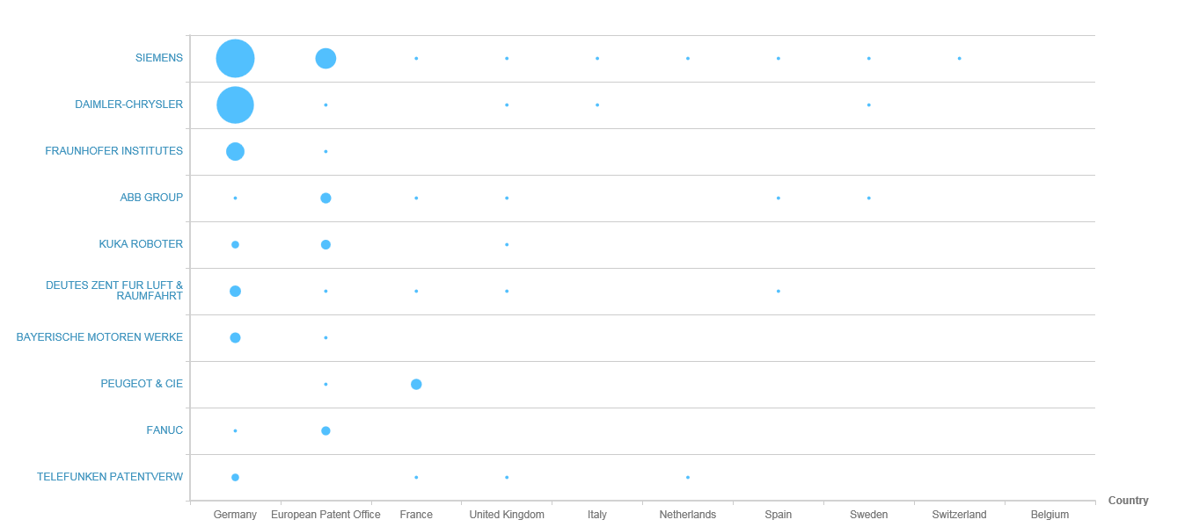
European leaders: Activity
The graph shows the number of patents the top organisations in the technology field hold within the top 10 jurisdictions in Europe.
Helpful for determining which geographical markets the top organisations in the technology field are focusing on and looking to commercialise their products in. This indicates the most successful global markets the technology has penetrated.
Automation and robotics

Slide 20
Top 10 European players
Indicators Profile | SIEMENS | DAIMLER-CHRYSLER | FRAUNHOFER INSTITUTES | ABB GROUP | KUKA ROBOTER | DEUTES ZENT FUR LUFT & RAUMFAHRT | BAYERISCHE MOTOREN WERKE | PEUGEOT & CIE | FANUC | TELEFUNKEN PATENTVERW
Annual Sales | - | $ 169,586m | - | - | - | - | $ 104,193m | $ 59,785m | $ 4,950m | -
Portfolio Size | 689 | 383 | 206 | 202 | 246 | 164 | 122 | 145 | 139 | 107
Employee Number | - | 282,488 | - | - | - | - | 124,729 | 196,885 | 6,738 | -
R&D Expense | - | $ 4,618,604,786 | - | - | - | - | $ 6,486,406,626 | $ 1,542,485,643 | - | -
R&D Expense % | - | 2.72% | - | - | - | - | 6.23% | 2.58% | - | -
Technology Diversity | Extremely diverse | Extremely diverse | Extremely diverse | Extremely diverse | Extremely specialised | Extremely diverse | Extremely diverse | Extremely specialised | Extremely diverse | Extremely specialised
Started Filling | 1879 | 1969 | 1956 | 1920 | 1979 | 1986 | 1917 | 1902 | 1973 | 1935
Geographic Diversity | Extremely concentrated | Extremely concentrated | Extremely concentrated | Concentrated | Extremely concentrated | Extremely concentrated | Extremely concentrated | Extremely concentrated | Concentrated | Concentrated
Automation and robotics

Slide 21
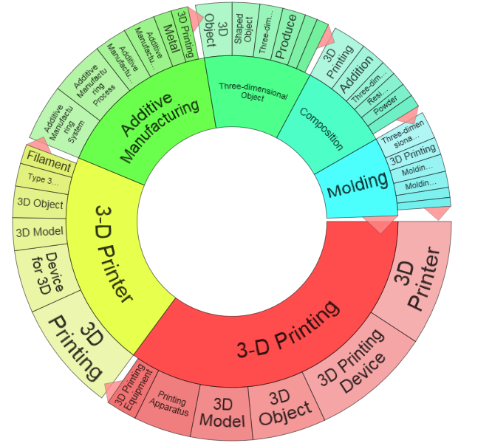
Additive manufacturing/
3D printing
Materials, production and nano-tech:
Global patents: 29,510 patent families
European patents: 1,951
Danish patents: 41
TA:(3D* $w3 print* ) OR TA:(three* $w3 dimensio* $w3 print*) OR CPC:(B33Y30/00 OR B33Y50/00 OR B33Y40/00 OR B33Y10/00 OR B33Y50/02 OR B33Y70/00) or IPC:(B33Y OR B33Y10/00 OR B33Y30/00 OR B33Y40/00 OR B33Y70/00 OR B33Y50/00) NOT PN:(CN)

Slide 22
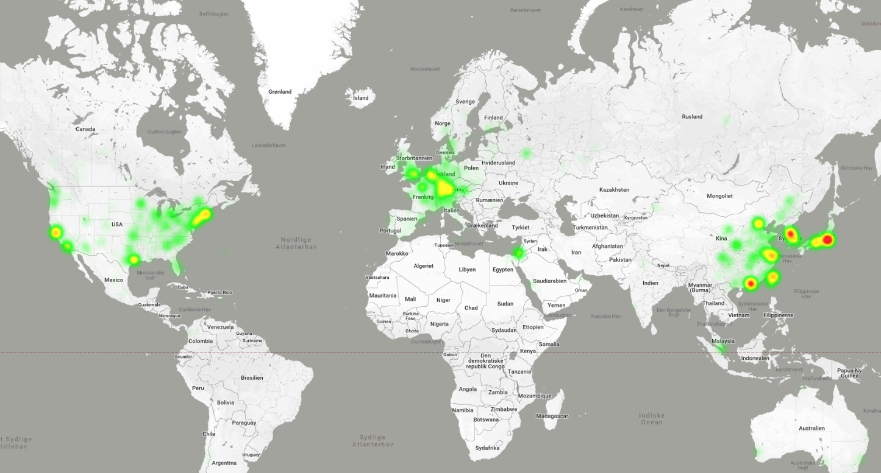
Additive manufacturing/3D printing 2017–2018, weight by citations

Slide 23
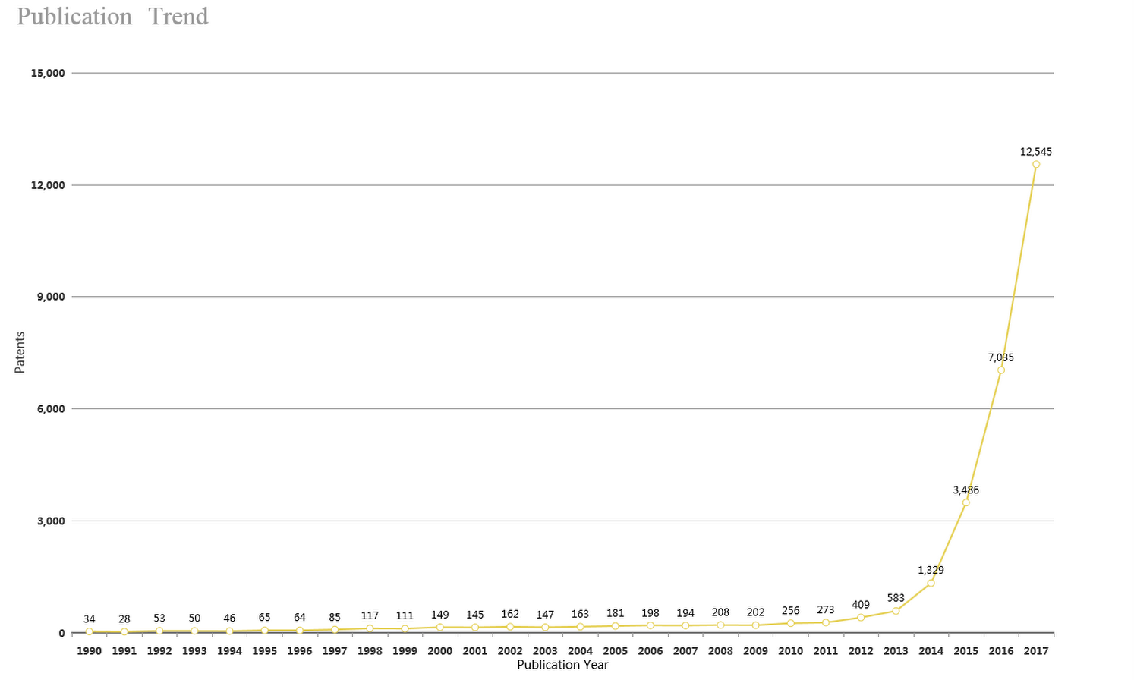
Publication trend 1990–2017
Additive manufacturing/3D printing

Slide 24
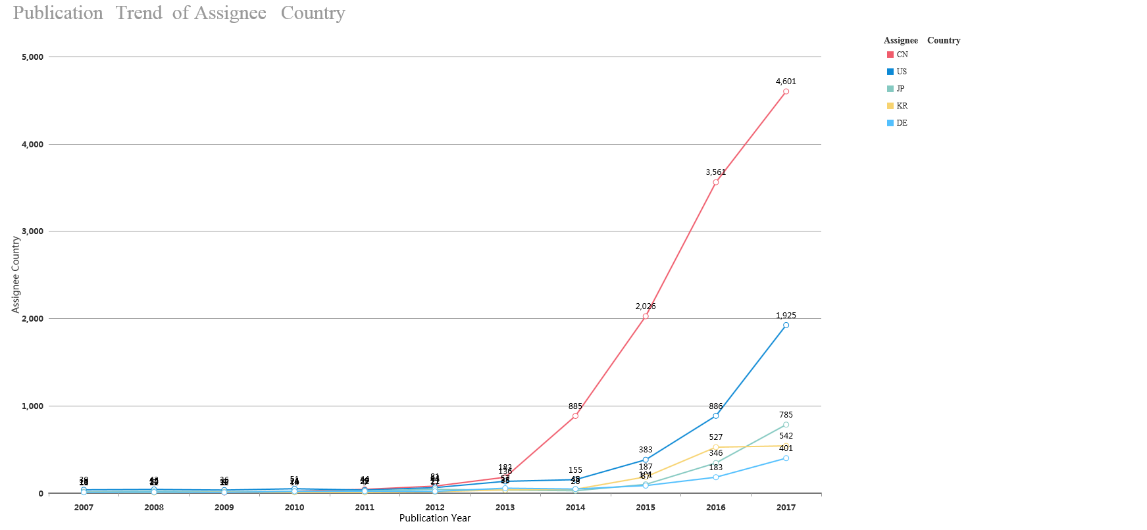
Publication trend of main countries - 10 years
Additive manufacturing/3D printing

Slide 25
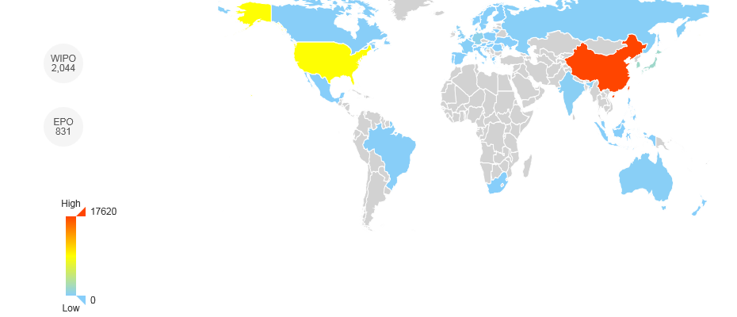

Additive manufacturing/3D printing, all patents

Slide 26
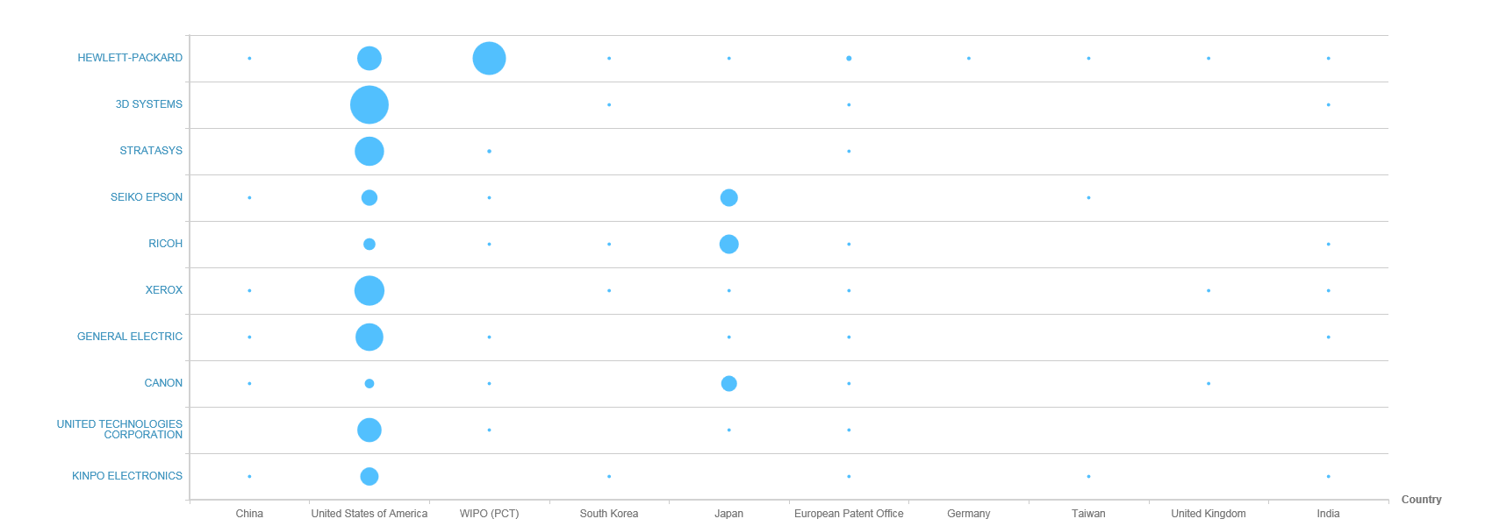
Global leaders
The graph shows the number of patents the top organisations in the technology field hold within the top 10 jurisdictions in the world
Helpful for determining which geographical markets the top organisations in the technology field are focusing on and looking to commercialise their products in. This indicates the most successful global markets the technology has penetrated.
Additive manufacturing/3D printing

Slide 27
Top 10 global players
Indicators Profile | HEWLETT-PACKARD | 3D SYSTEMS | STRATASYS | SEIKO EPSON | RICOH | XEROX | GENERAL ELECTRIC | CANON | UNITED TECHNOLOGIES CORPORATION | KINPO ELECTRONICS
Annual Sales | - | $ 636m | $ 672m | $ 9,449m | $ 18,706m | $ 10,265m | $ 120,468m | $ 31,362m | $ 59,837m | $ 3,813m
Portfolio Size | 498 | 322 | 293 | 254 | 253 | 239 | 237 | 211 | 199 | 174
Employee Number | - | 2,445 | 2,469 | 72,420 | 105,613 | 37,600 | 295,000 | 197,673 | 202,000 | 515
R&D Expense | - | $ 96m | - | $ 447m | $ 824m | $ 385m | $ 4,249m | - | $ 2,475m | $ 13m
R&D Expense % | - | 14.66% | - | 4.74% | 4.41% | 3.75% | 3.53% | - | 4.14% | 0.35%
Technology Diversity | Extremely diverse | Specialised | Moderate | Moderate | Extremely specialised | Extremely specialised | Diverse | Specialised | Extremely specialised | Specialised
Started Filling | 1939 | 1967 | 1986 | 1960 | 1959 | 1900 | 1887 | 1902 | 1961 | 1973
Geographic Diversity | Extremely concentrated | Extremely concentrated | Extremely concentrated | Extremely concentrated | Extremely concentrated | Extremely concentrated | Extremely concentrated | Extremely concentrated | Extremely concentrated | Extremely concentrated
Additive manufacturing/3D printing

Slide 28
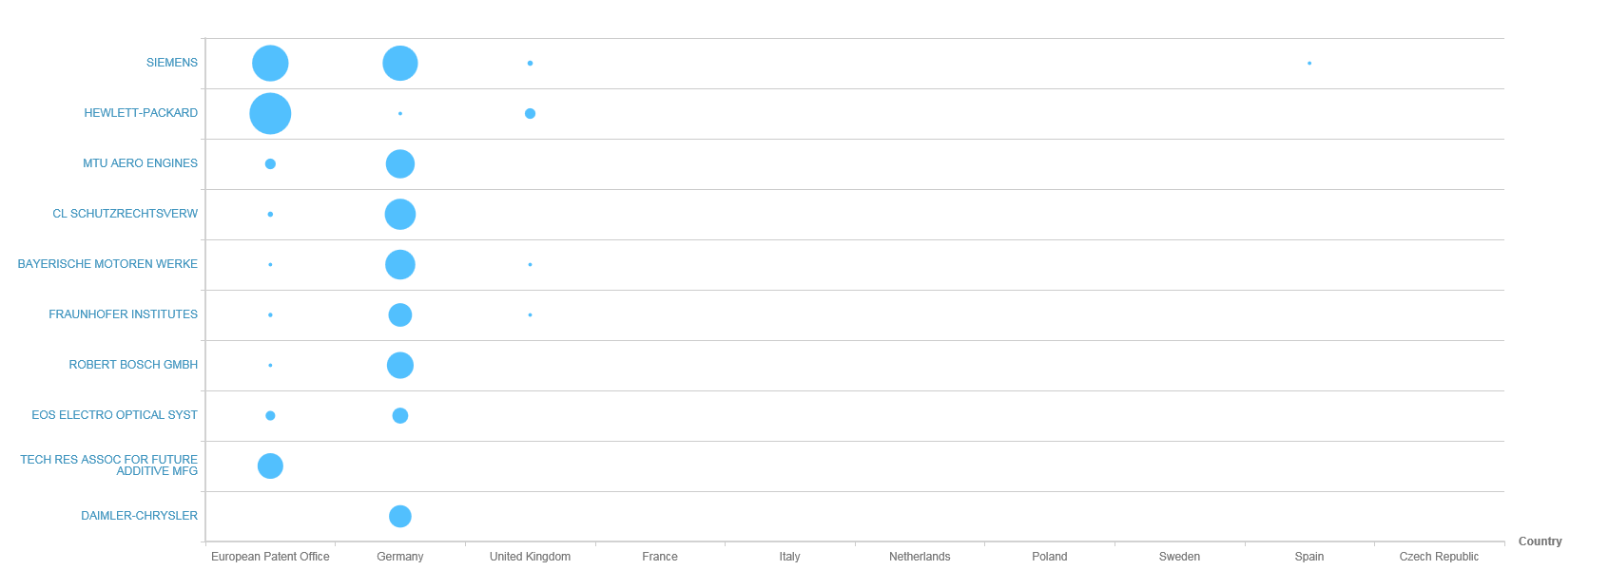
European leaders: Activity
The graph shows the number of patents the top organisations in the technology field hold within the top 10 jurisdictions in Europe
Helpful for determining which geographical markets the top organisations in the technology field are focusing on and looking to commercialise their products in. This indicates the most successful global markets the technology has penetrated.
Additive manufacturing/3D printing

Slide 29
Top 5 European players
Indicators Profile | SIEMENS | HEWLETT-PACKARD | MTU AERO ENGINES | CL SCHUTZRECHTSVERW | BAYERISCHE MOTOREN WERKE | FRAUNHOFER INSTITUTES | ROBERT BOSCH GMBH | EOS ELECTRO OPTICAL SYST | TECH RES ASSOC FOR FUTURE ADDITIVE MFG | DAIMLER-CHRYSLER
Annual Sales | - | - | - | - | $ 104193m | - | - | - | - | $ 169,586m
Portfolio Size | 80 | 50 | 38 | 35 | 30 | 29 | 27 | 32 | 24 | 26
Employee Number | - | - | - | - | 124,729 | - | - | - | - | 282,488
R&D Expense | - | - | - | - | $ 6,486m | - | - | - | - | $ 4,618m
R&D Expense % | - | - | - | - | 6.23% | - | - | - | - | 2.72%
Technology Diversity | Diverse | Moderate | Extremely specialised | Extremely specialised | Extremely diverse | Moderate | Moderate | Extremely specialised | - | Extremely diverse
Started Filling | 1879 | 1939 | 1987 | 2000 | 1917 | 1956 | 1897 | 1991 | 2014 | 1969
Geographic Diversity | Concentrated | Extremely concentrated | Extremely concentrated | Moderate | Extremely concentrated | Moderate | Extremely concentrated | Moderate | Moderate | Concentrated
Additive manufacturing/3D printing

Slide 30
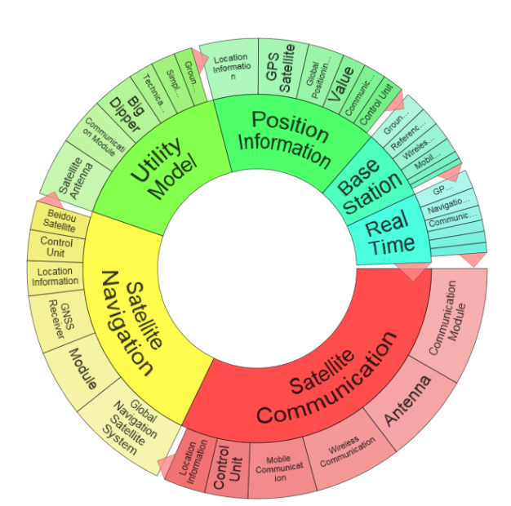
Satellites
Materials, production, and nano-tech:
Global patents: 72,750 patent families
European patents: 8,420
Danish patents: 46
CPC:(B64G1/10 OR B64G1/1007 OR B64G1/1014 OR B64G2700/00 OR B64G1/00 OR H04N21/6193 OR Y10S343/02) or [SEMANTIC]8ed94837-b934-4a4d-ab48-b2870820f88e or ABST:(satellit*) or CPC:(B64G1/1021 OR B64G1/1078 OR B64G1/66 OR B64G2001/643 OR B64G1/1007 OR B64G2700/00) NOT PN:(CN)

Slide 31
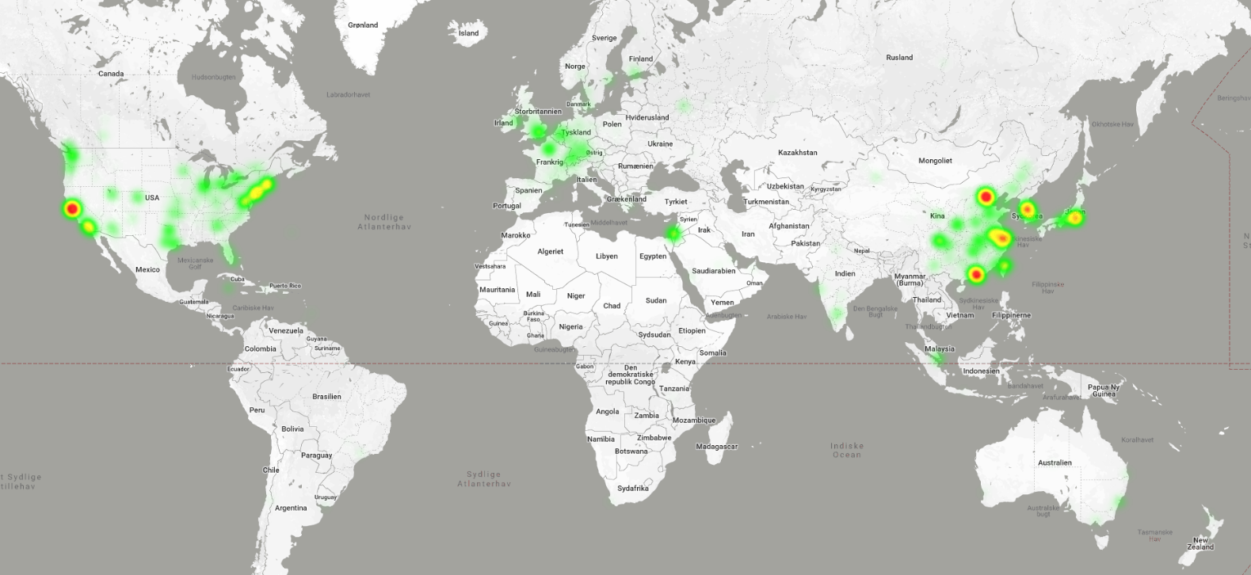
Satellites 2017–2018, based on 10,000 patents

Slide 32
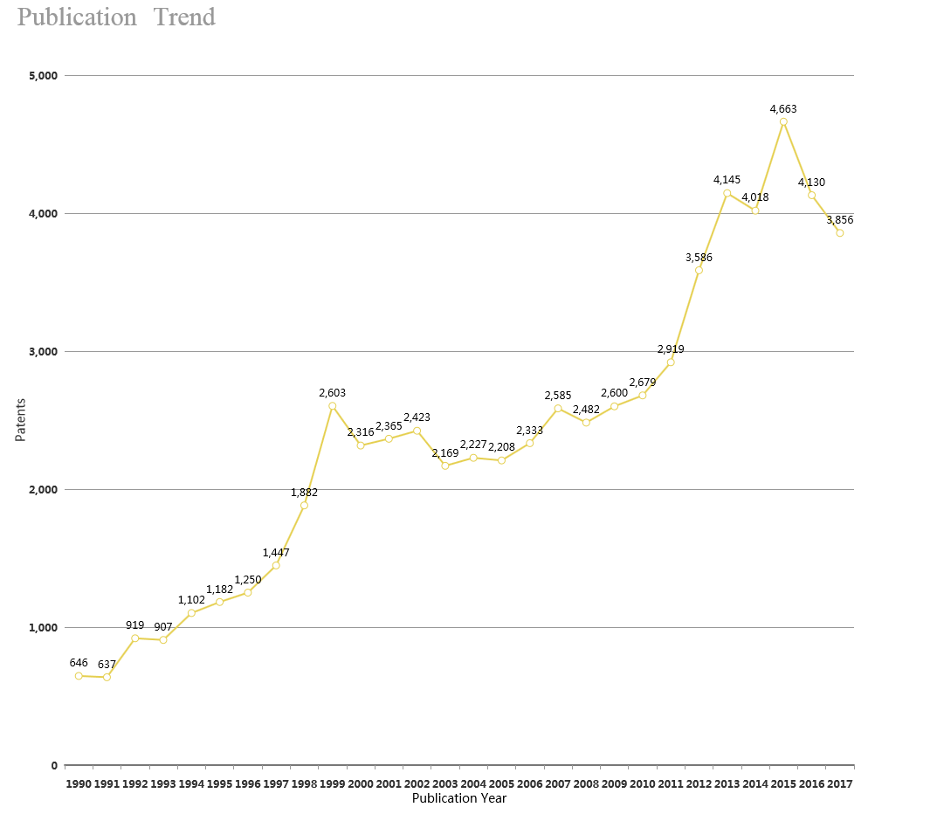
Publication trend 1990–2017
Satellites

Slide 33
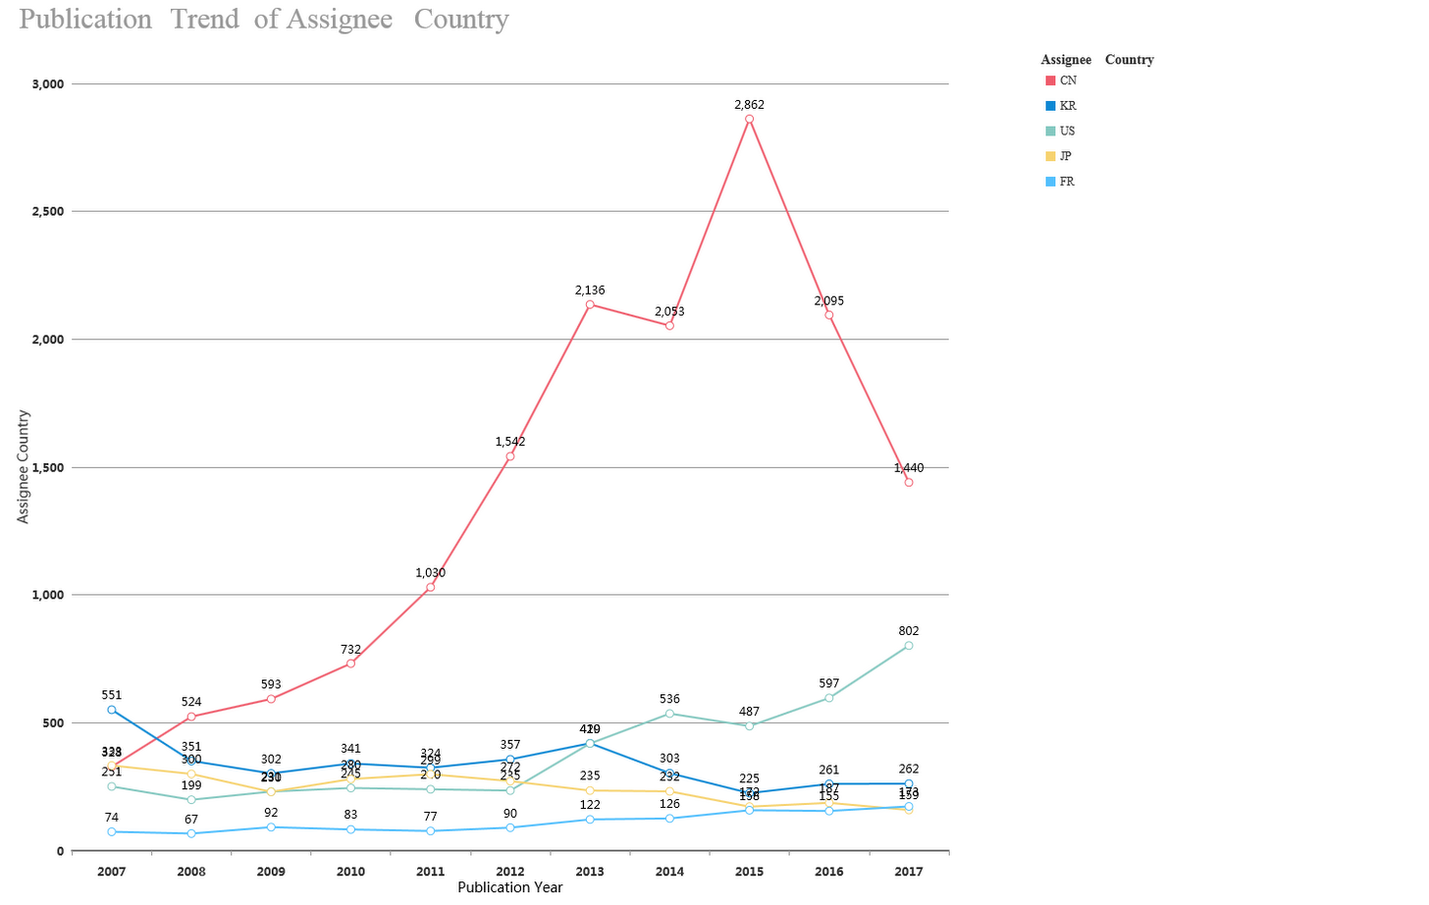
Publication trend of main countries - 10 years
Satellites

Slide 34
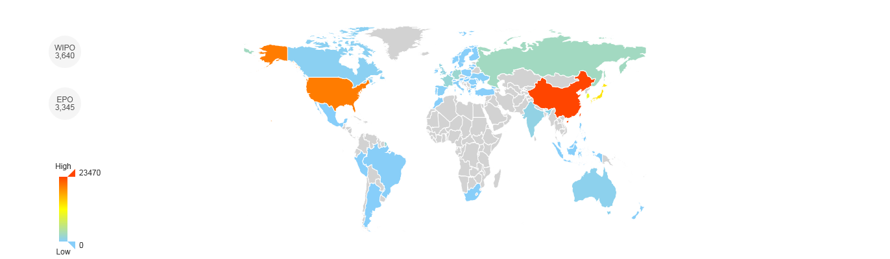

Satellites

Slide 35
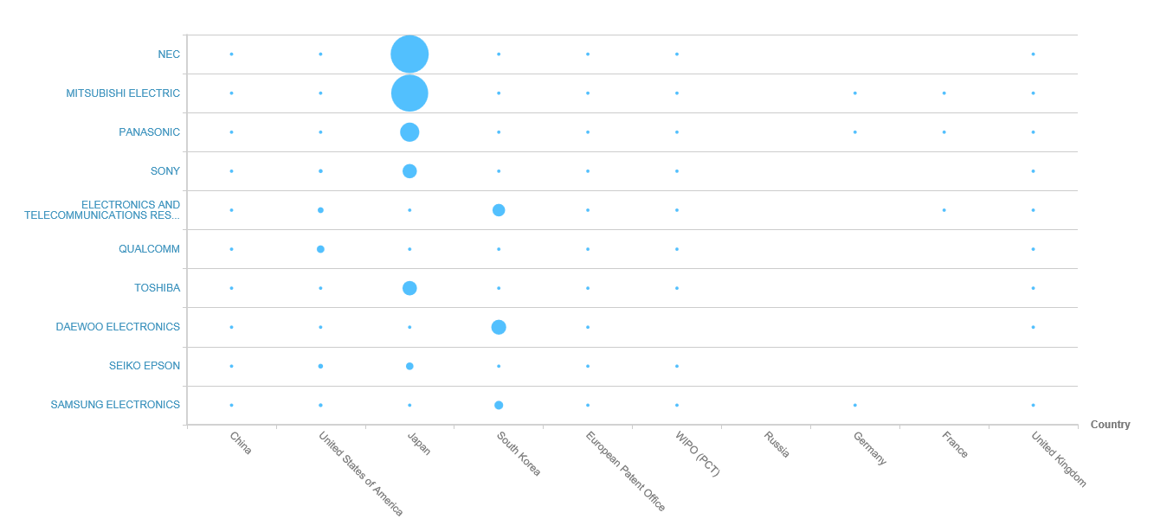
Global leaders
The graph shows the number of patents the top organisations in the technology field hold within the top 10 jurisdictions in the world
Helpful for: Determining which geographical markets the top organisations in the technology field are focusing on and looking to commercialise their products in. This indicates the most successful global markets in which the technology has penetrated.
Satellites

Slide 36
Top 10 global players
Indicators Profile | NEC | MITSUBISHI ELECTRIC | PANASONIC | SONY | ELECTRONICS AND TELECOMMUNICATIONS RESEARCH INSTITUTE | QUALCOMM | TOSHIBA | DAEWOO ELECTRONICS | SEIKO EPSON | SAMSUNG ELECTRONICS
Annual Sales | $ 24,572m | $ 39,081m | $ 67,710m | - | - | $ 22,291m | $ 44,909m | - | $ 9,449m | $ 174,121m
Portfolio Size | 1,755 | 1,684 | 896 | 851 | 777 | 685 | 656 | 605 | 576 | 557
Employee Number | 107,729 | 138,700 | 257,533 | - | - | 33,800 | 153,492 | - | 72,420 | 93,200
R&D Expense | $ 2,650m | - | $ 4,046m | - | - | - | $ 3,240m | - | $ 447m | $ 6,371m
R&D Expense % | 10.79% | - | 5.98% | - | - | - | 7.22% | - | 4.74% | 3.66%
Technology Diversity | Extremely diverse | Extremely diverse | Extremely diverse | Extremely specialised | Extremely diverse | Diverse | Extremely specialised | Extremely specialised | Extremely diverse | Extremely diverse
Started Filling | 1937 | 1932 | 1949 | 1900 | 1970 | 1985 | 1937 | 1979 | 1960 | 1964
Geographic Diversity | Extremely concentrated | Extremely concentrated | Extremely concentrated | Extremely concentrated | Extremely concentrated | Moderate | Extremely concentrated | Extremely concentrated | Concentrated | Extremely concentrated
Satellites

Slide 37
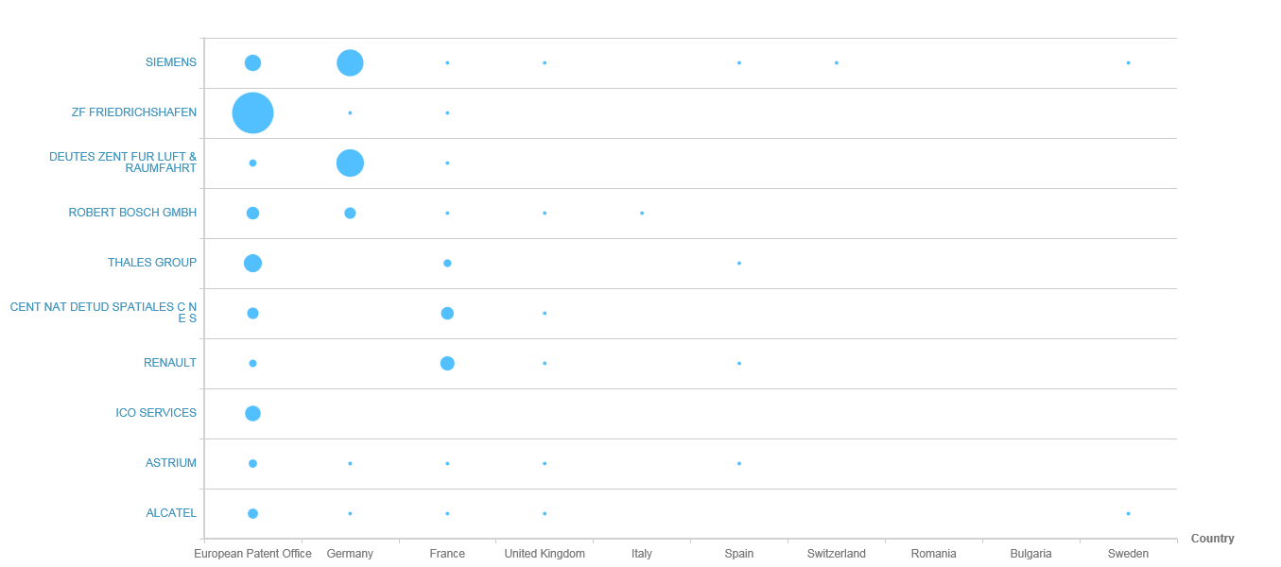
European leaders: Activity
The graph shows the number of patents the top organisations in the technology field hold within the top 10 jurisdictions in Europe
Helpful for determining which geographical markets the top organisations in the technology field are focusing on and looking to commercialise their products in. This indicates the most successful global markets the technology has penetrated.
Satellites

Slide 38
Top 10 European players
Indicators Profile | SIEMENS | ZF FRIEDRICHSHAFEN | DEUTES ZENT FUR LUFT & RAUMFAHRT | ROBERT BOSCH GMBH | THALES GROUP | CENT NAT DETUD SPATIALES C N E S | RENAULT | ICO SERVICES | ASTRIUM | ALCATEL
Portfolio Size | 202 | 162 | 145 | 105 | 113 | 100 | 89 | 74 | 99 | 125
Portfolio Value | $ 4,690,000 | $ 51,650,000 | $ 5,355,000 | $ 3,830,000 | $ 26,790,000 | $ 11,085,000 | $ 850,000 | $ 140,000 | $ 15,160,000 | $ 2,080,000
Technology Diversity | Diverse | Extremely diverse | Extremely diverse | Extremely diverse | Extremely specialised | Diverse | Extremely diverse | Extremely specialised | Moderate | Diverse
Average Simple Family Value | $ 260,555 | $ 478,240 | $ 63,000 | $ 98,205 | $ 301,011 | $ 149,797 | $ 40,476 | $ 70,000 | $ 256,949 | $ 138,666
Started Filling | 1879 | 1925 | 1986 | 1897 | 1980 | 1966 | 1902 | 1996 | 1992 | 1956
Geographic Diversity | Extremely concentrated | Extremely concentrated | Extremely concentrated | Moderate | Extremely concentrated | Extremely concentrated | Extremely concentrated | Extremely concentrated | Extremely concentrated | Extremely concentrated
Satellites

Slide 39
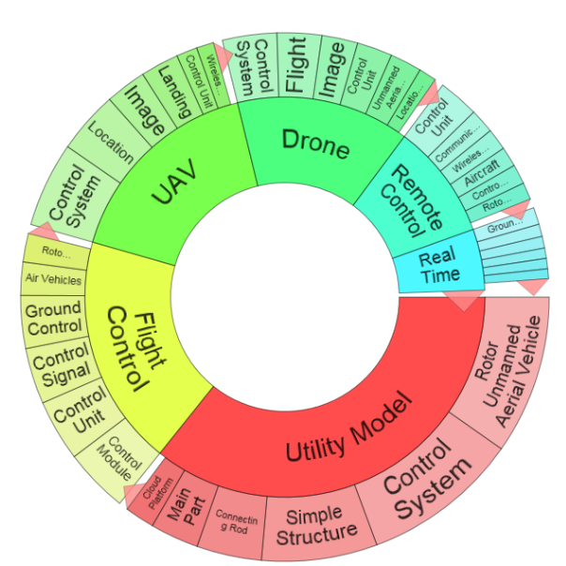
Drones / UAV
The present invention relates to a method for removing animals from an area before mowing the area, the method comprising: Identifying one or more animals present in the area by use of a unmanned aerial vehicle (UAV) the day before initiation of mowing, and if one or more animals are detected within the area, releasing an animal repellent from the UAV, at and/or near the identified animal(s).
Materials, production, and nano-tech:
ABST:("Unmanned Arial Vehicle") or ABST:( "unmanned aerial") or CPC:(B64C2201/00 OR B64C2201/02 OR B64C2201/021 OR B64C2201/022 OR B64C2201/024 OR B64C2201/025 OR B64C2201/027 OR B64C2201/028 OR B64C2201/04 OR B64C2201/042 OR B64C2201/044 OR B64C2201/046 OR B64C2201/048 OR B64C2201/06 OR B64C2201/063 OR B64C2201/066 OR B64C2201/08 OR B64C2201/082 OR B64C2201/084 OR B64C2201/086 OR B64C2201/088 OR B64C2201/10 OR B64C2201/101 OR B64C2201/102 OR B64C2201/104 OR B64C2201/105 OR B64C2201/107 OR B64C2201/108 OR B64C2201/12 OR B64C2201/121 OR B64C2201/122 OR B64C2201/123 OR B64C2201/125 OR B64C2201/126 OR B64C2201/127 OR B64C2201/128 OR B64C2201/14 OR B64C2201/141 OR B64C2201/143 OR B64C2201/145 OR B64C2201/146 OR B64C2201/148 OR B64C2201/16 OR B64C2201/162 OR B64C2201/165 OR B64C2201/167 OR B64C2201/18 OR B64C2201/182 OR B64C2201/185 OR B64C2201/187 OR B64C2201/20 OR B64C2201/201 OR B64C2201/203 OR B64C2201/205 OR B64C2201/206 OR B64C2201/208 OR B64C2201/22) NOT PN:(CN)
Global patents: 11,766 patent families
European patents: 669
Danish patents: 3
The present invention relates to a method for removing animals from an area before mowing the area. The method comprises identifying one or more animals present in the area by using an unmanned aerial vehicle (UAV) the day before initiating the mowing, and if one or more animals are detected in the area, releasing an animal repellent from the UAV, at and/or near the identified animal(s). Patent PCT/DK2015/050155 – Aarhus University

Slide 40
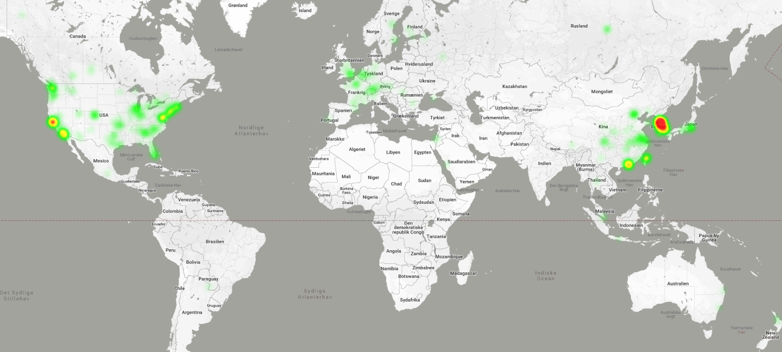
Drones 2017–2018, based on 4,972 patents

Slide 41
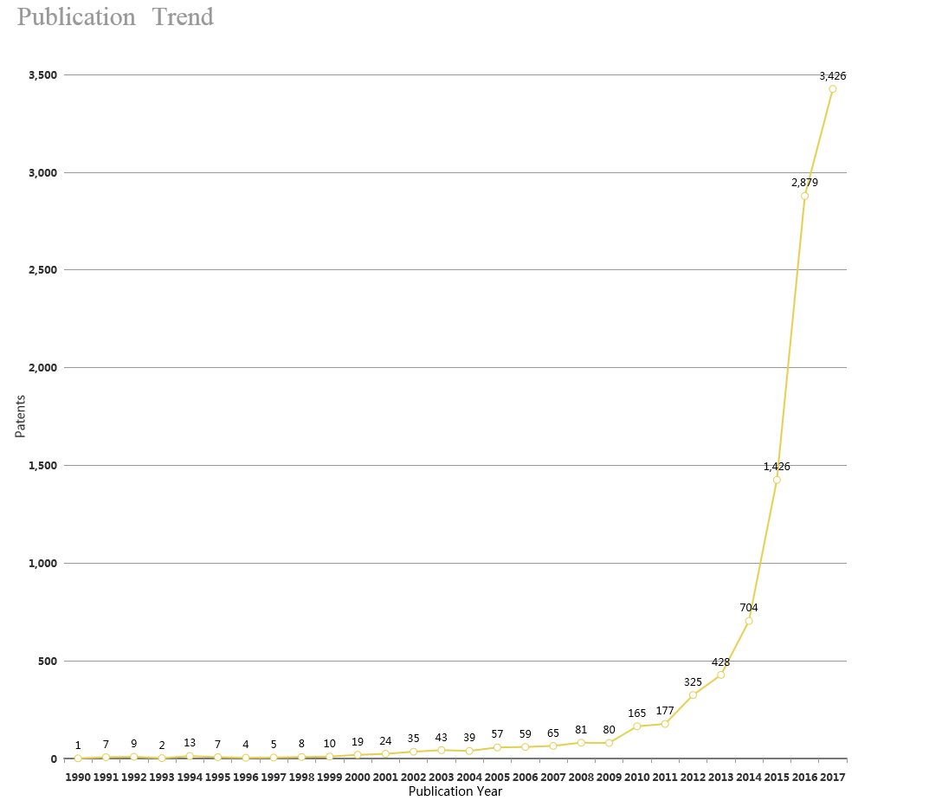
Publication trend 1990–2017
Drones

Slide 42
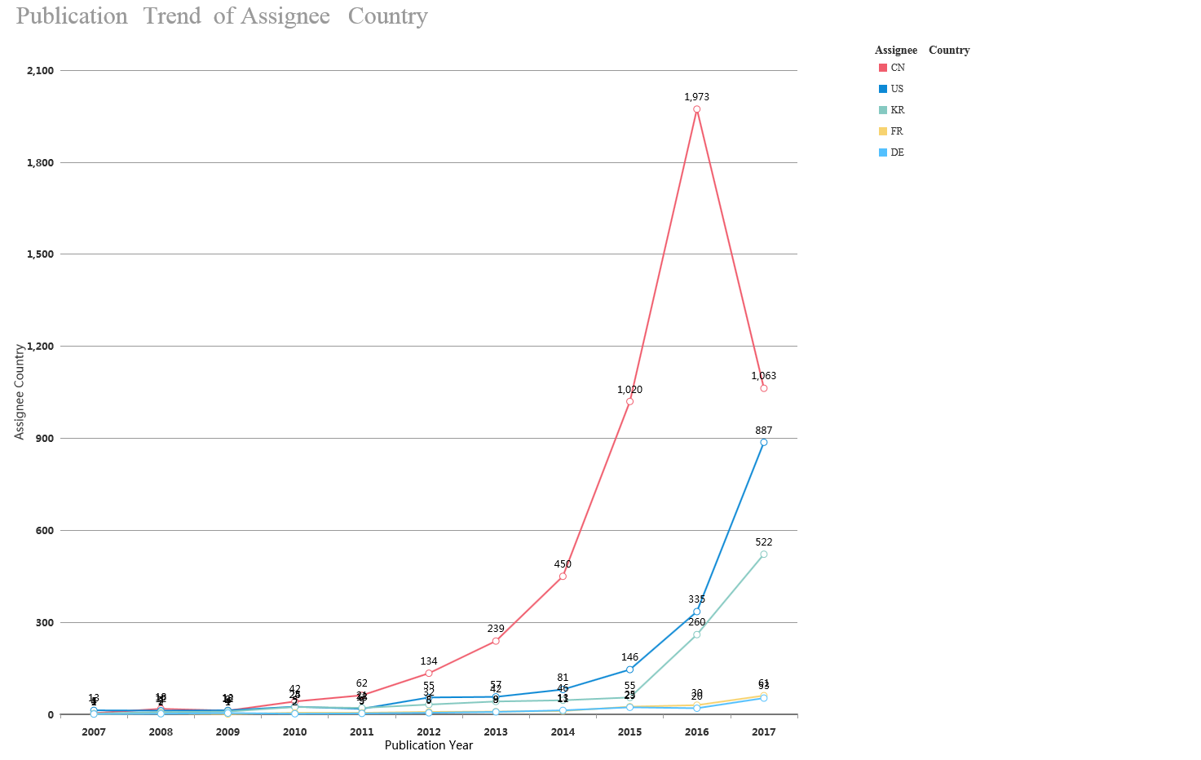
Publication trend of main countries - 10 years
Drones

Slide 43
Drones

Slide 44
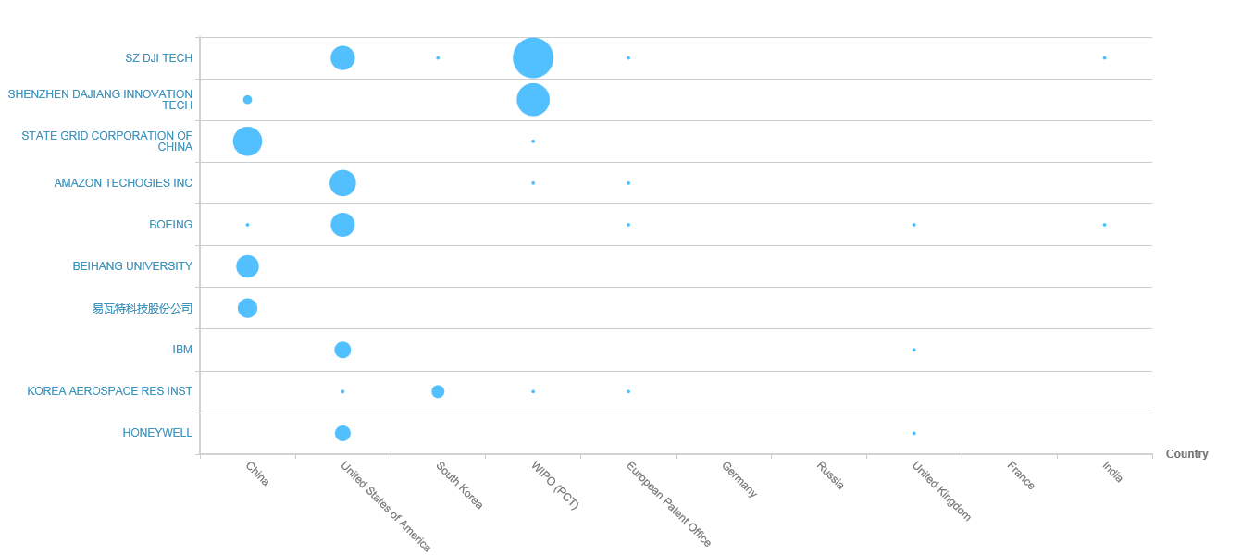
Global leaders
The graph shows the number of patents the top organisations in the technology field hold within the top 10 jurisdictions in the world
Helpful for determining which geographical markets the top organisations in the technology field are focusing on and looking to commercialise their products in. This indicates the most successful global markets the technology has penetrated.
Drones

Slide 45
Top 10 global players
Indicators Profile | SZ DJI TECH | SHENZHEN DAJIANG INNOVATION TECH | STATE GRID CORPORATION OF CHINA | AMAZON TECHOGIES INC | BOEING | BEIHANG UNIVERSITY | EWAT Aerospace | IBM | KOREA AEROSPACE RES INST | HONEYWELL
Annual Sales | - | - | - | - | $ 93,392,000,000 | - | - | $ 79,139,000,000 | - | $ 40,534,000,000
Portfolio Size | 361 | 261 | 149 | 142 | 145 | 113 | 98 | 84 | 84 | 80
Employee Number | - | - | - | - | 150,500 | - | - | 414,400 | - | 131,000
R&D Expense | - | - | - | - | $ 2,205,000,000 | - | - | $ 5,226,000,000 | - | $ 1,450,000,000
R&D Expense % | - | - | - | - | 2.36% | - | - | 6.60% | - | 3.58%
Technology Diversity | - | Specialised | Extremely specialised | - | Extremely diverse | Extremely specialised | Extremely specialised | Extremely diverse | Moderate | Extremely diverse
Started Filling | 2010 | 2008 | 2000 | 1995 | 1929 | 1985 | 2013 | 1900 | 1994 | 1914
Drones

Slide 46
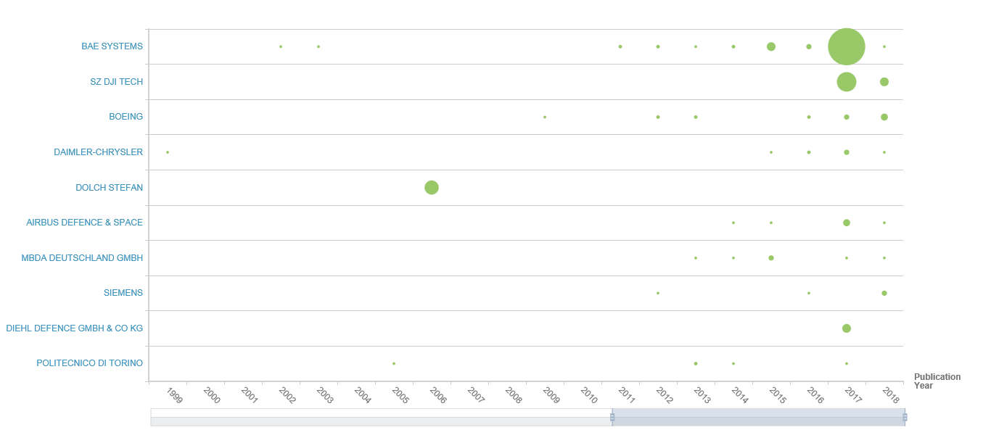
European leaders: Activity
The graph shows the number of patents the top organisations in the technology field hold within the top 10 jurisdictions in Europe
Helpful for determining which geographical markets the top organisations in the technology field are focusing on and looking to commercialise their products in. This indicates the most successful global markets the technology has penetrated.
Drones

Slide 47
Top 10 European players
Indicators Profile | BAE SYSTEMS | SZ DJI TECH | BOEING | DAIMLER-CHRYSLER | DOLCH STEFAN | AIRBUS DEFENCE & SPACE | MBDA DEUTSCHLAND GMBH | SIEMENS | DIEHL DEFENCE GMBH & CO KG | POLITECNICO DI TORINO
Annual Sales | $ 24,102,903,016 | - | $ 93,392,000,000 | $ 169,586,005,787 | - | - | - | - | - | -
Portfolio Size | 39 | 21 | 17 | 8 | 8 | 11 | 8 | 7 | 5 | 5
Employee Number | 76,346 | - | 150,500 | 282,488 | - | - | - | - | - | -
R&D Expense | $ 1,541,827,073 | - | $ 2,205,000,000 | $ 4,618,604,786 | - | - | - | - | - | -
R&D Expense % | 6.40% | - | 2.36% | 2.72% | - | - | - | - | - | -
Technology Diversity | Specialised | - | Extremely diverse | Extremely diverse | Extremely specialised | Specialised | Moderate | Specialised | - | Diverse
Started Filling | 1973 | 2010 | 1929 | 1969 | 1999 | 1999 | 2002 | 1879 | 2003 | 1979
Geographic Diversity | Moderate | Extremely concentrated | Extremely concentrated | Concentrated | Extremely concentrated | Extremely concentrated | Extremely distributed | Concentrated | Extremely concentrated | Concentrated
Drones

Slide 48
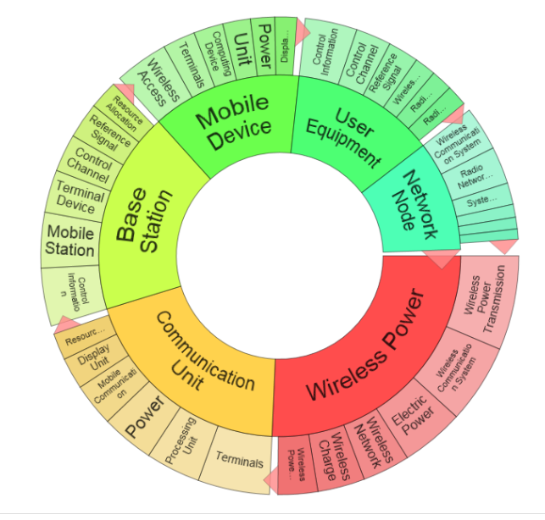
Wireless communication
The present invention relates to a method for removing animals from an area before mowing the area, the method comprising: Identifying one or more animals present in the area by use of a unmanned aerial vehicle (UAV) the day before initiation of mowing, and if one or more animals are detected within the area, releasing an animal repellent from the UAV, at and/or near the identified animal(s).
Materials, production, and nano-tech:
Global patents: 333,334 patent families
European patents: 32,503
Danish patents: 521
TA:(wireless*) NOT PN:(CN)

Slide 49
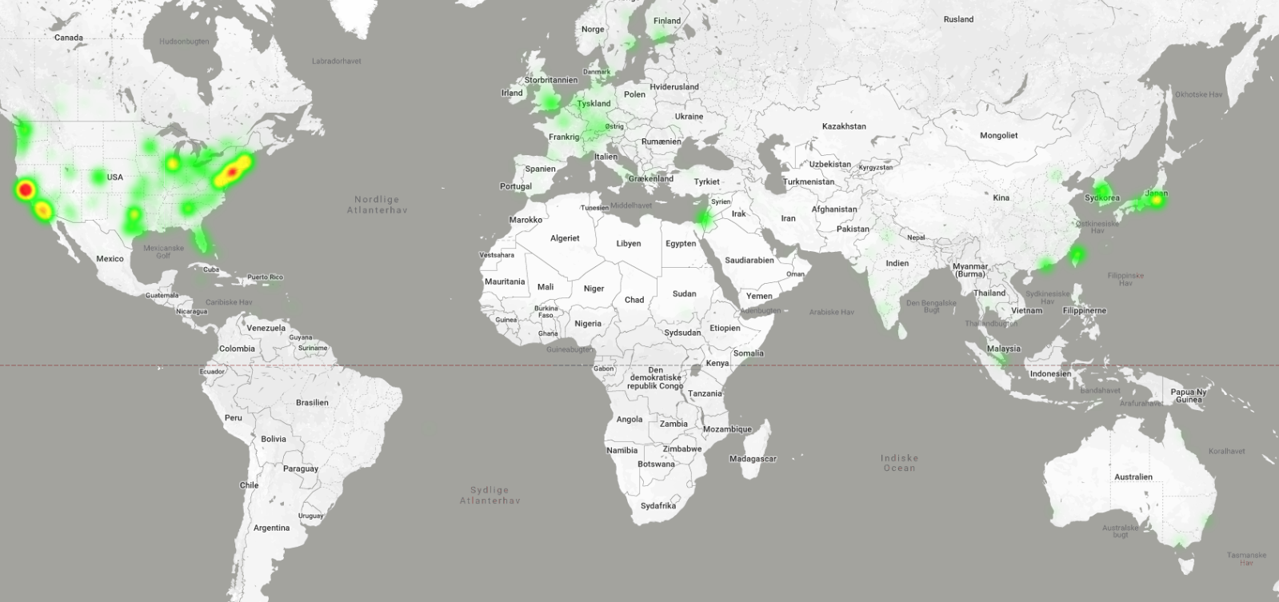
Wireless communication 2017–2018, based on 10,000 patents

Slide 50
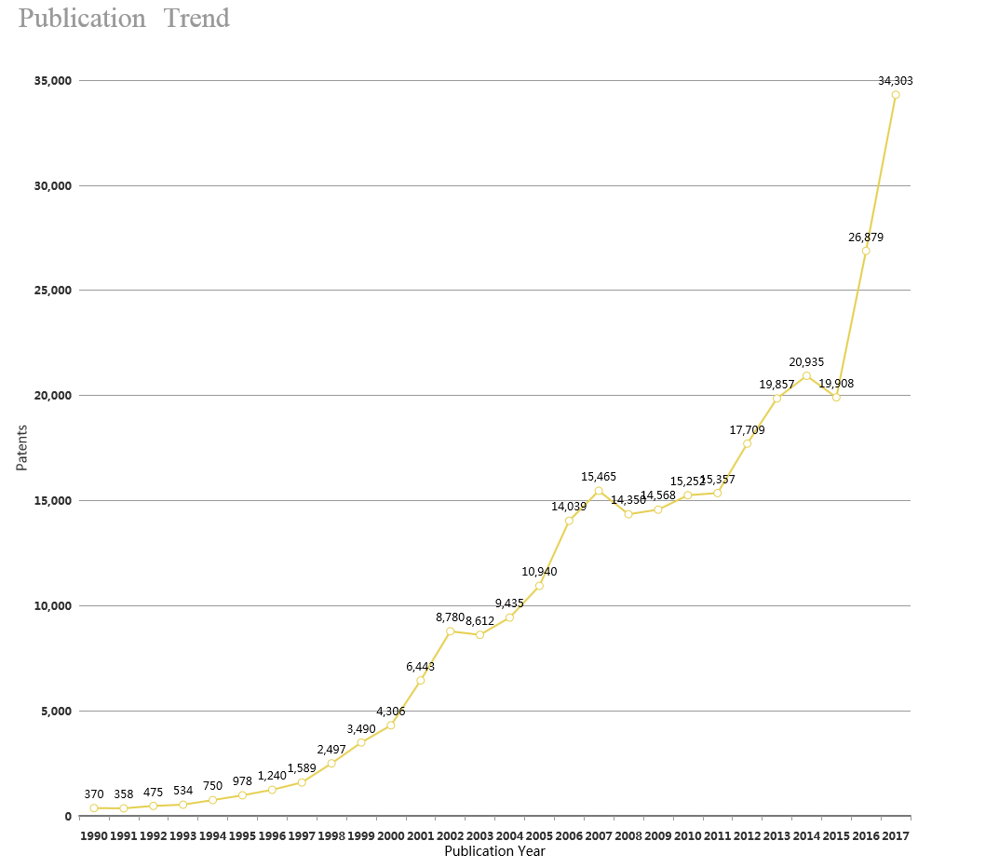
Publication trend 1990–2017
Wireless communication

Slide 51
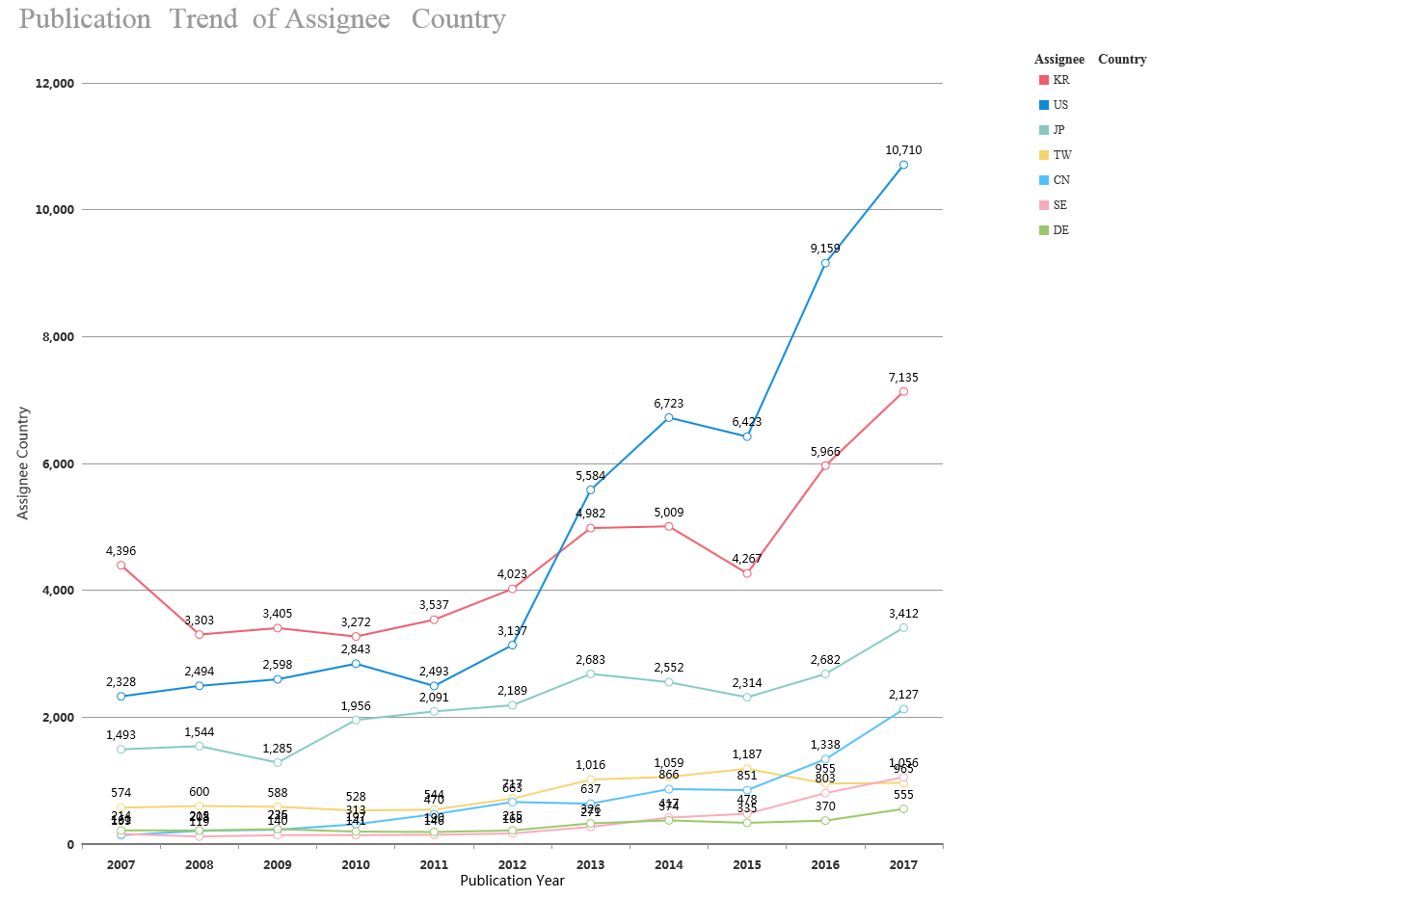
Publication trend of main countries - 10 years
Wireless communication

Slide 52


Wireless communication

Slide 53
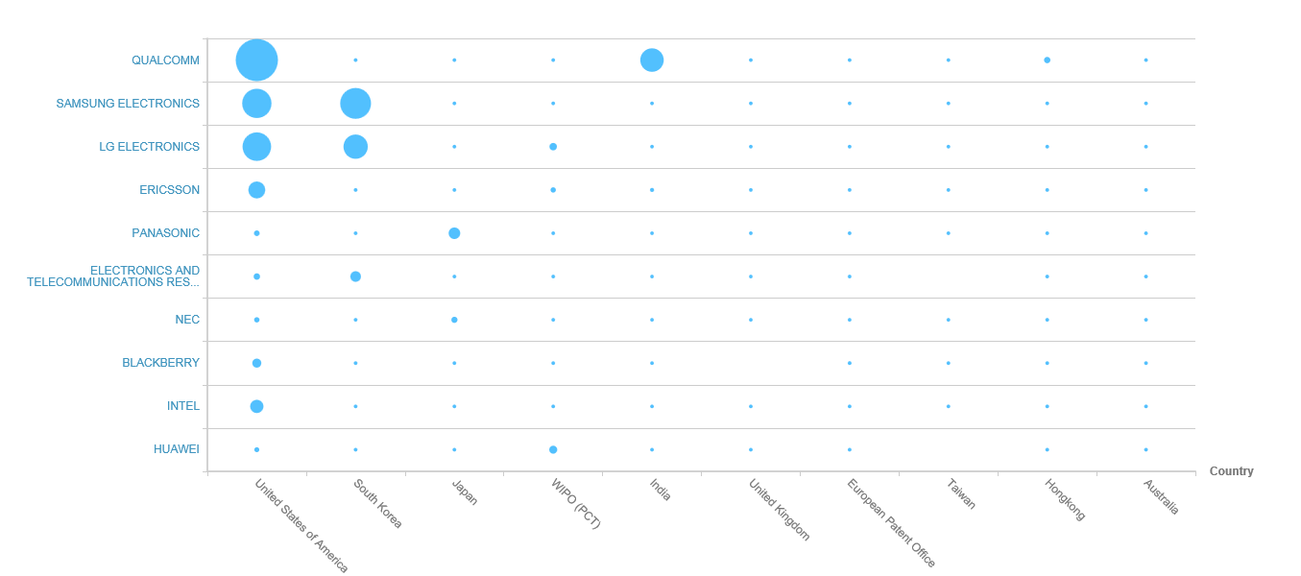
Global leaders
The graph shows the number of patents the top organisations in the technology field hold within the top 10 jurisdictions in the world
Helpful for determining which geographical markets the top organisations in the technology field are focusing on and looking to commercialise their products in. This indicates the most successful global markets the technology has penetrated.
Wireless communication

Slide 54
Top 10 global players
Indicators Profile | QUALCOMM | SAMSUNG ELECTRONICS | LG ELECTRONICS | ERICSSON | PANASONIC | ELECTRONICS AND TELECOMMUNICATIONS RESEARCH INSTITUTE | NEC | BLACKBERRY | INTEL | HUAWEI
Annual Sales | $ 22,291m | $ 174,121m | $ 52,957m | - | $ 67,710m | - | $ 24,572m | $ 1,296m | $ 62,761m | -
Portfolio Size | 17,754 | 13,448 | 12,976 | 6,618 | 4,628 | 3,609 | 3,641 | 3,405 | 3,523 | 3,571
Employee Number | 33,800 | 93,200 | 37,902 | - | 257,533 | - | 107,729 | 4,044 | 106,000 | -
R&D Expense | - | $ 6,371m | $ 1,780m | - | $ 4,046m | - | $ 2,650m | $ 329m | $ 11,951m | -
R&D Expense % | - | 3.66% | 3.36% | - | 5.98% | - | 10.79% | 25.44% | 19.04% | -
Technology Diversity | Diverse | Extremely diverse | Specialised | Diverse | Extremely diverse | Extremely diverse | Extremely diverse | Extremely diverse | Extremely diverse | Extremely diverse
Started Filling | 1985 | 1964 | 1963 | 1926 | 1949 | 1970 | 1937 | 1968 | 1969 | 1993
Geographic Diversity | Extremely concentrated | Extremely concentrated | Extremely concentrated | Extremely concentrated | Extremely concentrated | Extremely concentrated | Concentrated | Concentrated | Extremely concentrated | Concentrated
Wireless communication

Slide 55
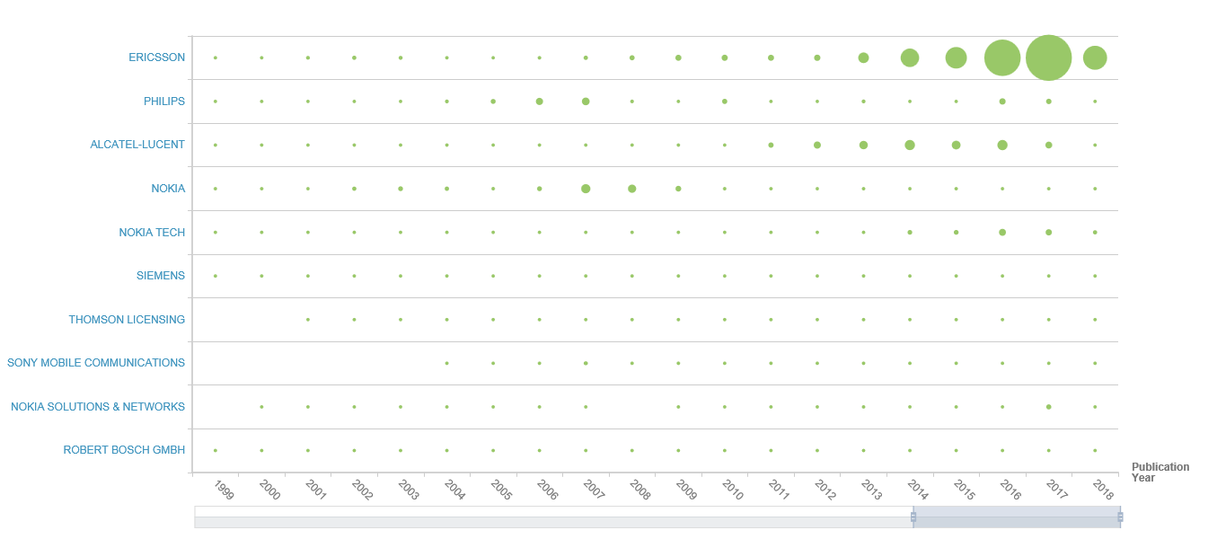
European leaders: Activity
The graph shows the number of patents the top organisations in the technology field hold within the top 10 jurisdictions in Europe
Helpful for determining which geographical markets the top organisations in the technology field are focusing on and looking to commercialise their products in. This indicates the most successful global markets the technology has penetrated.
Wireless communication

Slide 56
Top 10 European players
Indicators Profile | ERICSSON | PHILIPS | ALCATEL-LUCENT | NOKIA | NOKIA TECH | SIEMENS | THOMSON LICENSING | SONY MOBILE COMMUNICATIONS | NOKIA SOLUTIONS & NETWORKS | ROBERT BOSCH GMBH
Annual Sales | - | - | - | $ 26,129,308,439 | - | - | - | - | - | -
Portfolio Size | 4,538 | 1,771 | 1,598 | 2,112 | 1,022 | 920 | 550 | 566 | 456 | 343
Employee Number | - | - | - | 102,687 | - | - | - | - | - | -
R&D Expense | - | - | - | $ 2,037,099,044 | - | - | - | - | - | -
R&D Expense % | - | - | - | 7.80% | - | - | - | - | - | -
Technology Diversity | Diverse | Extremely diverse | Extremely Diverse | Extremely diverse | Extremely diverse | Extremely diverse | Extremely specialised | Specialised | Diverse | Extremely diverse
Started Filling | 1926 | 1900 | 1991 | 1965 | 1989 | 1879 | 1979 | 1998 | 1995 | 1897
Geographic Diversity | Extremely concentrated | Concentrated | Distributed | Concentrated | Extremely concentrated | Concentrated | Moderate | Moderate | Extremely concentrated | Extremely concentrated
Wireless communication

Slide 57
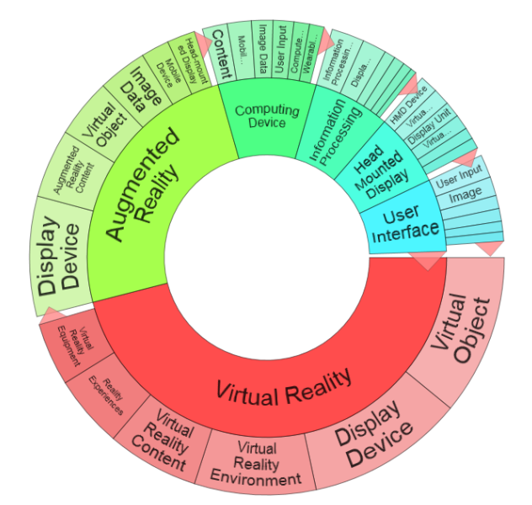
Virtual reality and augmented reality
The present invention relates to a method for removing animals from an area before mowing the area, the method comprising: Identifying one or more animals present in the area by use of a unmanned aerial vehicle (UAV) the day before initiation of mowing, and if one or more animals are detected within the area, releasing an animal repellent from the UAV, at and/or near the identified animal(s).
ICT
Global patents: 36,892 patent families
European patents: 3,826
Danish patents: 73
TAC:("Virtual reality") OR TAC:("Augmented reality") or CPC:(G05B2219/39451 OR G05B2219/39449 OR G05B2219/32014 OR G06K9/00671 OR H04M2203/359 OR H04N2201/3245 OR A61B2090/365) or CPC:(A63F13/12 OR A63F2300/8082 OR G05B2219/32246 OR G05B2219/36432 OR G05B2219/40131 OR G05D1/0044 OR G06F3/011 OR H04L29/06034 OR H04L29/06401 OR H04L29/08126 OR H04L65/4015 OR H04L67/08 OR H04L67/38) or CPC:(A61B2090/365 OR G05B2219/32014 OR G05B2219/39449 OR G05B2219/39451 OR G06K9/00671 OR H04M2203/359 OR H04N2201/3245) or [SEMANTIC]7dc9ad06-7c7f-40e4-b802-76b36f6458f5 NOT PN:(CN)

Slide 58
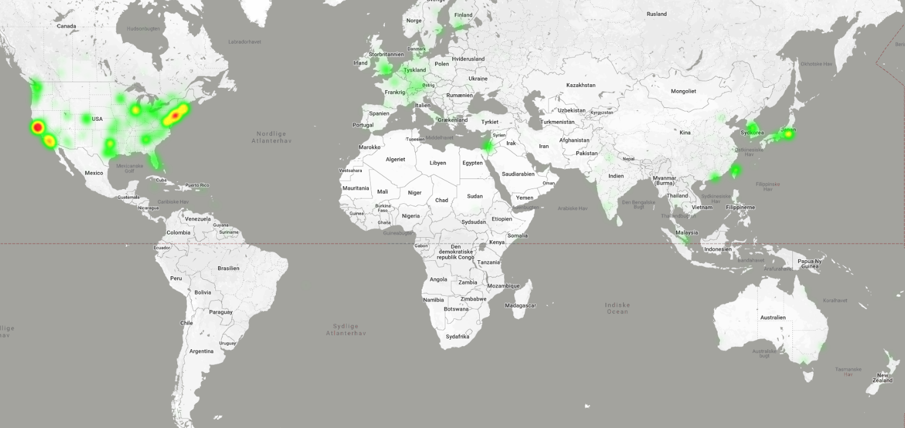
Virtual reality 2017–2018, based on 10,000 patents

Slide 59
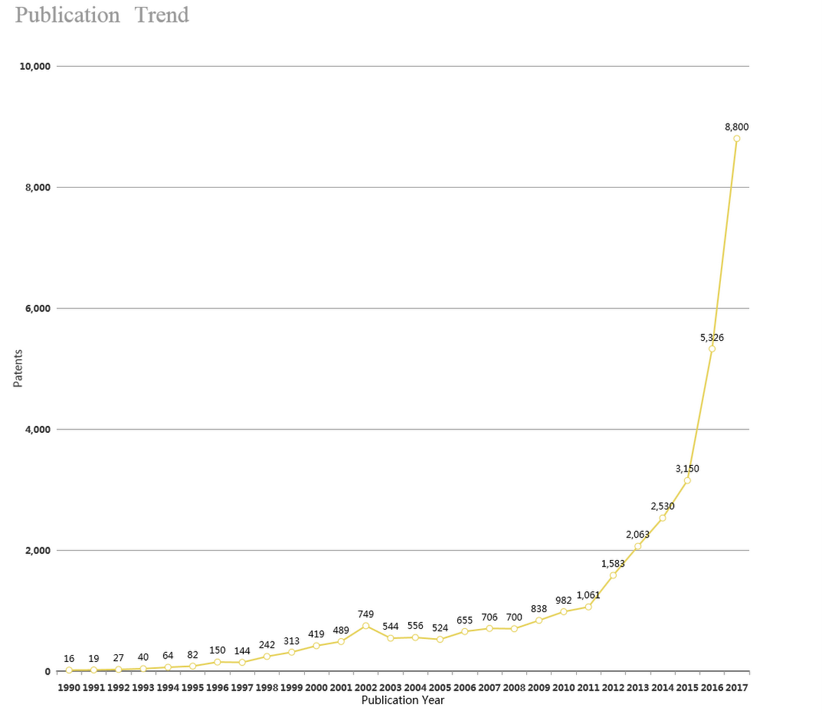
Publication trend 1990–2017
Virtual reality

Slide 60
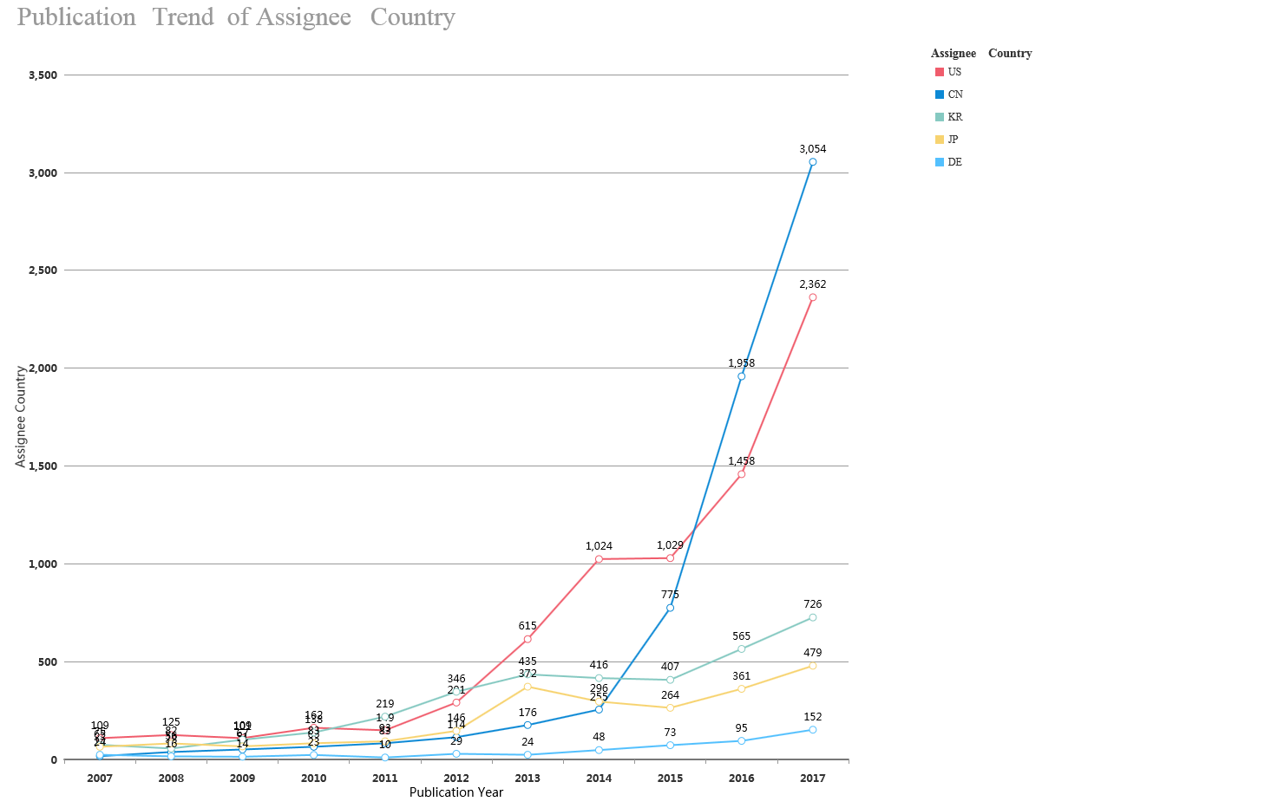
Publication trend of main countries - 10 years
Virtual reality

Slide 61
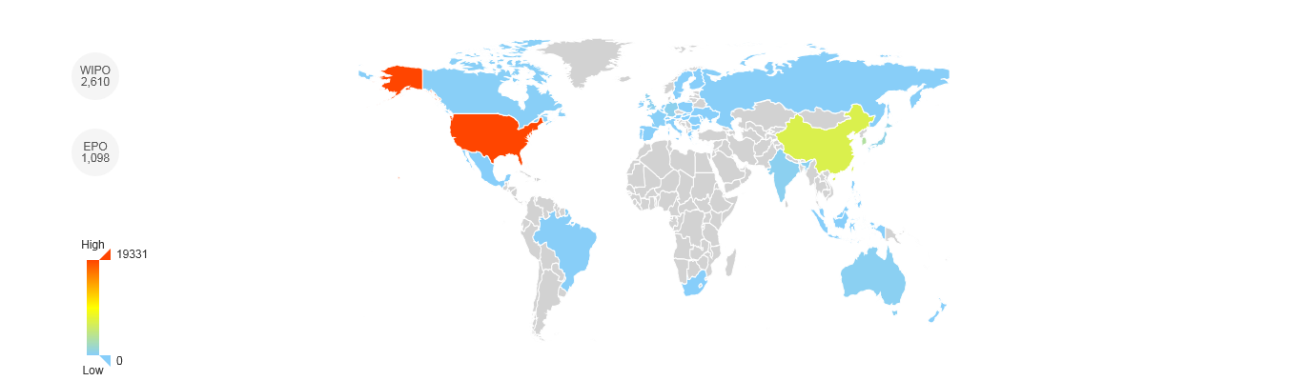

Virtual reality

Slide 62
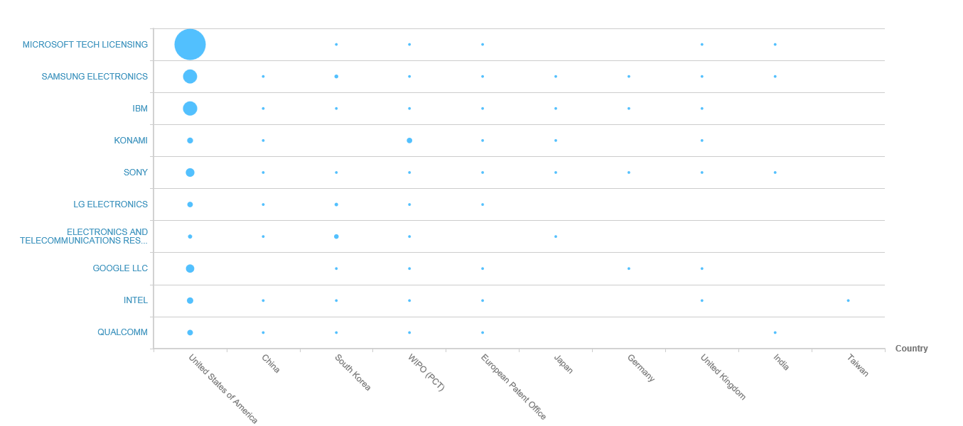
Global leaders
The graph shows the number of patents the top organisations in the technology field hold within the top 10 jurisdictions in the world
Helpful for determining which geographical markets the top organisations in the technology field are focusing on and looking to commercialise their products in. This indicates the most successful global markets the technology has penetrated.
Virtual reality

Slide 63
Top 10 global players
Indicators Profile | MICROSOFT TECH LICENSING | SAMSUNG ELECTRONICS | IBM | KONAMI | SONY | LG ELECTRONICS | ELECTRONICS AND TELECOMMUNI-CATIONS RESEARCH INSTITUTE | GOOGLE LLC | INTEL | QUALCOMM
Annual Sales | - | $ 174,121,896,954 | $ 79,139,000,000 | $ 2,119,929,560 | - | $ 52,957,892,772 | - | - | $ 62,761,000,000 | $ 22,291,000,000
Portfolio Size | 1,207 | 753 | 539 | 449 | 475 | 359 | 324 | 333 | 269 | 257
Employee Number | - | 93,200 | 414,400 | 4,606 | - | 37,902 | - | - | 106,000 | 33,800
R&D Expense | - | $ 6,371,471,961 | $ 5,226,000,000 | - | - | $ 1,780,054,420 | - | - | $ 11,951,000,000 | -
R&D Expense % | - | 3.66% | 6.60% | - | - | 3.36% | - | - | 19.04% | -
Technology Diversity | - | Extremely diverse | Extremely diverse | Extremely specialised | Extremely specialised | Extremely specialised | Diverse | - | Moderate | Specialised
Started Filling | 1984 | 1964 | 1900 | 1984 | 1900 | 1963 | 1970 | 1988 | 1969 | 1985
Geographic Diversity | Extremely concentrated | Extremely concentrated | Extremely concentrated | Extremely concentrated | Extremely concentrated | Extremely concentrated | Extremely concentrated | Extremely concentrated | Extremely concentrated | Extremely concentrated
Virtual reality

Slide 64
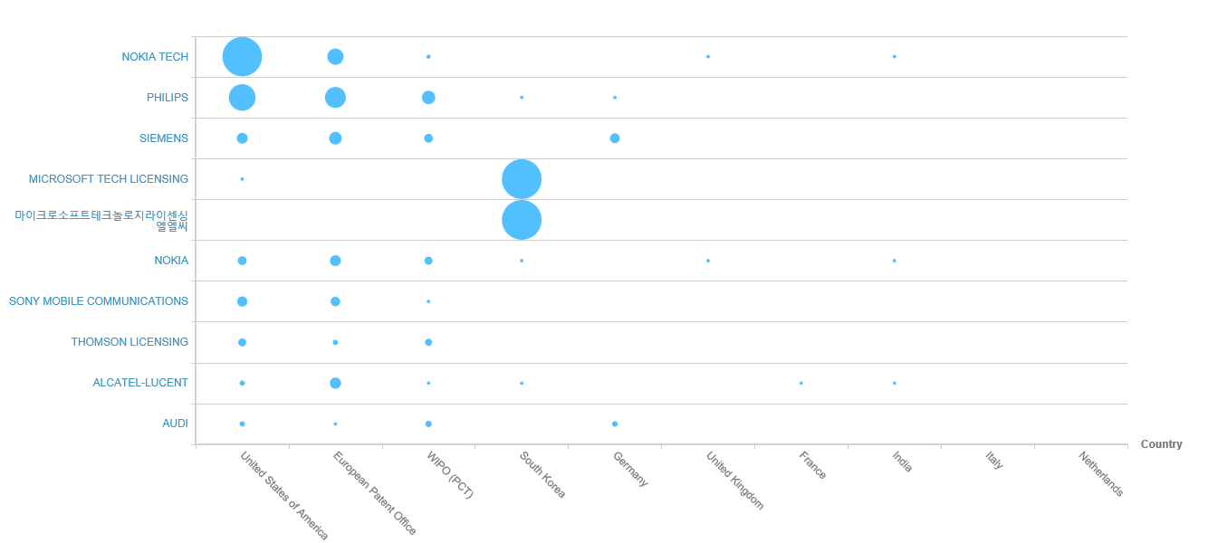
European leaders: Activity
The graph shows the number of patents the top organisations in the technology field hold within the top 10 jurisdictions in Europe
Helpful for determining which geographical markets the top organisations in the technology field are focusing on and looking to commercialise their products in. This indicates the most successful global markets the technology has penetrated.
Virtual reality

Slide 65
Top 10 European players
Indicators Profile | NOKIA TECH | PHILIPS | SIEMENS | MICROSOFT TECH LICENSING | Microsoft Technology Licensing LLC | NOKIA | SONY MOBILE COMMUNI-CATIONS | THOMSON LICENSING | ALCATEL-LUCENT | AUDI
Annual Sales | - | - | - | - | - | $ 26,129,308,439 | - | - | - | $ 65,635,309,082
Portfolio Size | 191 | 188 | 132 | 121 | 115 | 169 | 62 | 60 | 64 | 53
Employee Number | - | - | - | - | - | 102,687 | - | - | - | 88,453
R&D Expense | - | - | - | - | - | $ 2,037,099,044 | - | - | - | $ 2,780,678,924
R&D Expense % | - | - | - | - | - | 7.80% | - | - | - | 4.24%
Technology Diversity | Specialised | Extremely diverse | Diverse | - | - | Specialised | Extremely specialised | Extremely specialised | Diverse | Extremely specialised
Started Filling | 1989 | 1900 | 1879 | 1984 | 2007 | 1965 | 1998 | 1979 | 1991 | 1937
Geographic Diversity | Extremely concentrated | Extremely concentrated | Distributed | Extremely concentrated | Extremely concentrated | Extremely concentrated | Moderate | Moderate | Extremely concentrated | Extremely distributed
Virtual reality

Slide 66
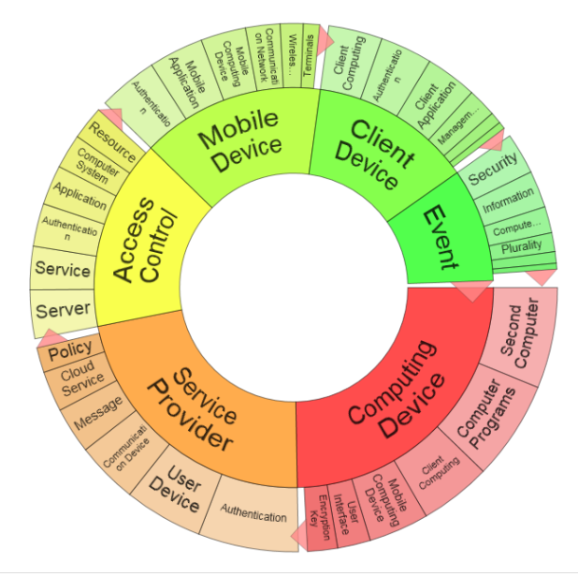
Cyber security
The present invention relates to a method for removing animals from an area before mowing the area, the method comprising: Identifying one or more animals present in the area by use of a unmanned aerial vehicle (UAV) the day before initiation of mowing, and if one or more animals are detected within the area, releasing an animal repellent from the UAV, at and/or near the identified animal(s).
ICT
TAC:("Cyber security") or CPC:(H04L63/00 OR H04L63/02 OR H04L63/0209 OR H04L63/0218 OR H04L63/0227 OR H04L63/0236 OR H04L63/0245 OR H04L63/0254 OR H04L63/0263 OR H04L63/0272 OR H04L63/0281 OR H04L63/029 OR H04L63/04 OR H04L63/0407 OR H04L63/0414 OR H04L63/0421 OR H04L63/0428 OR H04L63/0435 OR H04L63/0442 OR H04L63/045 OR H04L63/0457 OR H04L63/0464 OR H04L63/0471 OR H04L63/0478 OR H04L63/0485 OR H04L63/0492 OR H04L63/06 OR H04L63/061 OR H04L63/062 OR H04L63/064 OR H04L63/065 OR H04L63/067 OR H04L63/068 OR H04L63/08 OR H04L63/0807 OR H04L63/0815 OR H04L63/0823 OR H04L63/083 OR H04L63/0838 OR H04L63/0846 OR H04L63/0853 OR H04L63/0861 OR H04L63/0869 OR H04L63/0876 OR H04L63/0884 OR H04L63/0892 OR H04L63/10 OR H04L63/101 OR H04L63/102 OR H04L63/104 OR H04L63/105 OR H04L63/107 OR H04L63/108 OR H04L63/12 OR H04L63/123 OR H04L63/126 OR H04L63/14 OR H04L63/1408 OR H04L63/1416 OR H04L63/1425 OR H04L63/1433 OR H04L63/1441 OR H04L63/145 OR H04L63/1458 OR H04L63/1466 OR H04L63/1475 OR H04L63/1483 OR H04L63/1491 OR H04L63/16 OR H04L63/162 OR H04L63/164 OR H04L63/166 OR H04L63/168 OR H04L63/18 OR H04L63/20 OR H04L63/205 OR H04L63/30 OR H04L63/302 OR H04L63/304 OR H04L63/306 OR H04L63/308 OR H04K1/00 OR H04K2203/10 OR H04K2203/14 OR H04K2203/16 OR H04K2203/18 OR H04K2203/20 OR H04K2203/22 OR H04K2203/24 OR H04K2203/30 OR H04K2203/32 OR H04K2203/34 OR H04K2203/36 OR H04K2203/12 OR H04K1/003 OR H04K1/006 OR H04K1/02 OR H04K1/025 OR H04K1/04 OR H04K1/06 OR H04K1/08 OR H04K1/10) NOT PN:(CN)
Global patents: 83,109 patent families
European patents: 13,830
Danish patents: 12

Slide 67
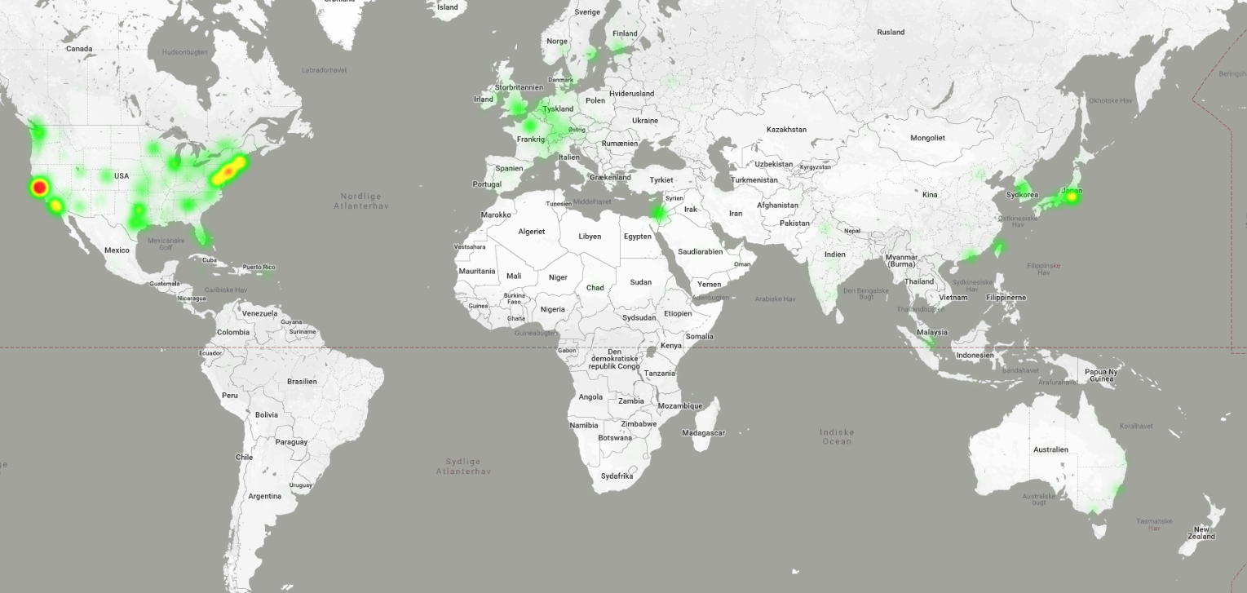
Cyber security 2017–2018, based on 10,000 patents

Slide 68
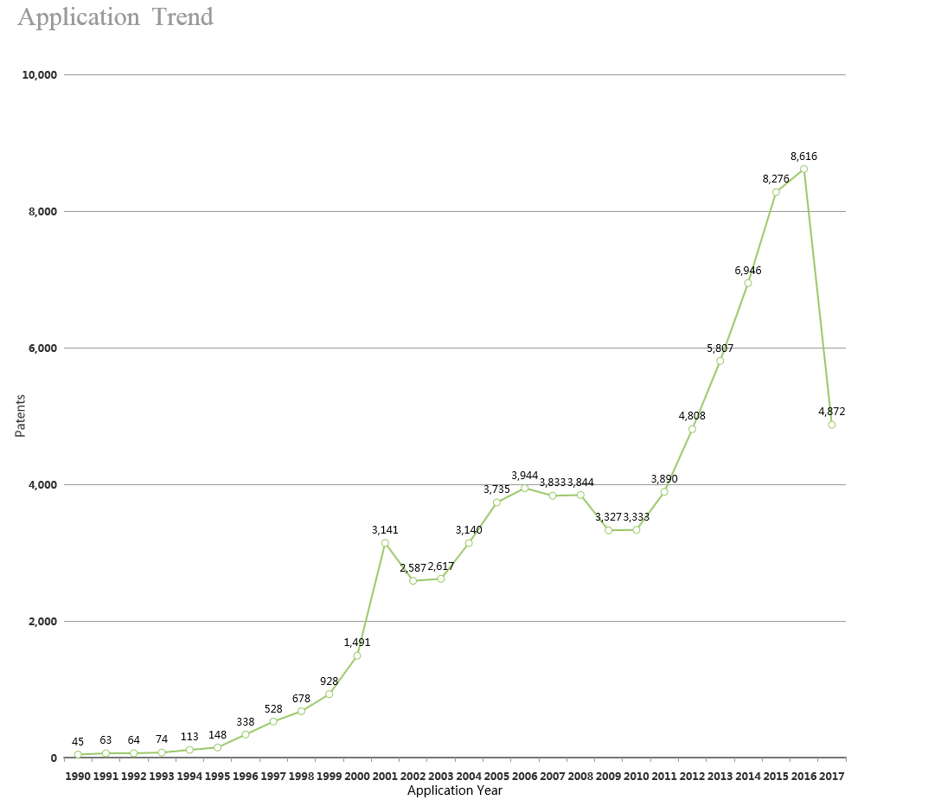
Publication trend 1990–2017
Cyber security

Slide 69

Publication trend of main countries - 10 years
Cyber security

Slide 70


Cyber security

Slide 71

Global leaders
The graph shows the number of patents the top organisations in the technology field hold within the top 10 jurisdictions in the world
Helpful for determining which geographical markets the top organisations in the technology field are focusing on and looking to commercialise their products in. This indicates the most successful global markets the technology has penetrated.
Cyber security

Slide 72
Top 10 global players
Indicators Profile | IBM | MICROSOFT TECH LICENSING | CISCO SYSTEMS | SAMSUNG ELECTRONICS | ERICSSON | HUAWEI | INTEL | QUALCOMM | ELECTRONICS AND TELECOMMU-NICATIONS RESEARCH INSTITUTE | FUJITSU
Annual Sales | $ 79,139,000,000 | - | $ 48,005,000,000 | $ 174,121,896,954 | - | - | $ 62,761,000,000 | $ 22,291,000,000 | - | $ 41,580,334,284
Portfolio Size | 3,343 | 2,392 | 1,686 | 1,463 | 1,390 | 1,433 | 1,222 | 946 | 904 | 851
Employee Number | 414,400 | - | 72,900 | 93,200 | - | - | 106,000 | 33,800 | - | 155,069
R&D Expense | $ 5,226,000,000 | - | - | $ 6,371,471,961 | - | - | $ 11,951,000,000 | - | - | $ 181,638,174
R&D Expense % | 6.60% | - | - | 3.66% | - | - | 19.04% | - | - | 0.44%
Technology Diversity | Extremely diverse | - | Extremely diverse | Extremely diverse | Diverse | Extremely diverse | Extremely diverse | Diverse | Extremely diverse | Extremely diverse
Started Filling | 1900 | 1984 | 1958 | 1964 | 1926 | 1993 | 1969 | 1985 | 1970 | 1963
Geographic Diversity | Extremely concentrated | Extremely concentrated | Extremely concentrated | Extremely concentrated | Extremely concentrated | Extremely concentrated | Extremely concentrated | Extremely concentrated | Concentrated | Extremely concentrated
Cyber security

Slide 73

European leaders: Activity
The graph shows the number of patents the top organisations in the technology field hold within the top 10 jurisdictions in Europe
Helpful for determining which geographical markets the top organisations in the technology field are focusing on and looking to commercialise their products in. This indicates the most successful global markets the technology has penetrated.
Cyber security

Slide 74
Top 10 European players
Indicators Profile | ERICSSON | SIEMENS | ALCATEL-LUCENT | NOKIA TECH | NOKIA | IBM | PHILIPS | SAP SE | MICROSOFT | GEMALTO
Annual Sales | - | - | - | - | $ 26,129,308,439 | $ 79,139,000,000 | - | $ 25,960,011,234 | $ 89,395,000,000 | $ 3,514,217,155
Portfolio Size | 1,078 | 692 | 633 | 494 | 867 | 290 | 288 | 249 | 246 | 238
Employee Number | - | - | - | - | 102,687 | 414,400 | - | 84,183 | 124,000 | 15,000
R&D Expense | - | - | - | - | $ 2,037,099,044 | $ 5,226,000,000 | - | $ 1,800,304,261 | $ 11,988,000,000 | $ 54,643,023
R&D Expense % | - | - | - | - | 7.80% | 6.60% | - | 6.93% | 13.41% | 1.55%
Technology Diversity | Diverse | Extremely diverse | Extremely diverse | Specialised | Extremely diverse | Extremely diverse | Extremely diverse | Extremely specialised | Extremely diverse | Extremely specialised
Started Filling | 1926 | 1879 | 1991 | 1989 | 1965 | 1900 | 1900 | 1962 | 1921 | 1990
Geographic Diversity | Extremely concentrated | Concentrated | Concentrated | Extremely concentrated | Extremely concentrated | Extremely concentrated | Concentrated | Extremely concentrated | Extremely concentrated | Extremely concentrated
Cyber security

Slide 75

Nano-tech
The present invention relates to a method for removing animals from an area before mowing the area, the method comprising: Identifying one or more animals present in the area by use of a unmanned aerial vehicle (UAV) the day before initiation of mowing, and if one or more animals are detected within the area, releasing an animal repellent from the UAV, at and/or near the identified animal(s).
Materials, production and nano-tech:
(TAC:("nano" or "nanometer rod" or "nano-material" or "nanometer particle" or "nanometer powder" or "nano material" or "nanosheet" or "nanometer composite material" or "nano-rod" or "nano-scale" or "nano-TiO2" or "nano powder" or "nanometer material") or CPC:(C01B32/15 OR F02G2250/31 OR G01R33/445 OR G06F2211/1042 OR H01F1/068 OR H01L29/0665 OR H01L29/0669 OR H01L29/413) ) NOT PN:(CN)
Global patents: 78,050 patent families
European patents: 9,732
Danish patents: 233

Slide 76

Nano-tech 2017–2018, based on 10,000 patents

Slide 77

Publication trend 1990–2017
Nano-tech

Slide 78

Publication trend of main countries - 10 years
Nano-tech

Slide 79


Nano-tech

Slide 80

Global leaders
The graph shows the number of patents the top organisations in the technology field hold within the top 10 jurisdictions in the world
Helpful for determining which geographical markets the top organisations in the technology field are focusing on and looking to commercialise their products in. This indicates the most successful global markets the technology has penetrated.
Nano-tech

Slide 81
Top 10 global players
Indicators Profile | SAMSUNG ELECTRONICS | KAIST | SAMSUNG SDI | KOREA INSTITUTE OF SCIENCE & TECHNOLOGY | Samsung SDI | KOREA UNIV RES & BUSINESS FOUND | IND ACADEMIC COOPERATION FOUND YONSEI UNIV | Korea Institute of Science and Technology | KOREA INST OF MACHINERY & MATERIALS | KOREA UNIVERSITY RESEARCH MANAGEMENT SYSTEM
Annual Sales | $ 174,121,896,954 | - | - | - | - | - | - | - | - | -
Portfolio Size | 1,700 | 852 | 841 | 682 | 729 | 596 | 542 | 623 | 532 | 551
Employee Number | 93,200 | - | - | - | - | - | - | - | - | -
R&D Expense | $ 6,371,471,961 | - | - | - | - | - | - | - | - | -
R&D Expense % | 3.66% | - | - | - | - | - | - | - | - | -
Technology Diversity | Extremely diverse | Extremely diverse | Extremely diverse | Extremely diverse | - | Diverse | Extremely diverse | - | Extremely diverse | -
Started Filling | 1964 | 1979 | 1984 | 1902 | 1984 | 2001 | 2000 | 1968 | 1983 | 2001
Geographic Diversity | Extremely concentrated | Extremely concentrated | Concentrated | Concentrated | Extremely concentrated | Extremely concentrated | Extremely concentrated | Extremely concentrated | Extremely concentrated | Extremely concentrated
Nano-tech

Slide 82

European leaders: Activity
The graph shows the number of patents the top organisations in the technology field hold within the top 10 jurisdictions in Europe
Helpful for determining which geographical markets the top organisations in the technology field are focusing on and looking to commercialise their products in. This indicates the most successful global markets the technology has penetrated.
Nano-tech

Slide 83
Top 10 European players
Indicators Profile | COMMISSARIAT A LENERGIE | CNRS | BASF | PHILIPS | SIEMENS | LOREAL CORP | FRAUNHOFER INSTITUTES | ARKEMA | MERCK | ROBERT BOSCH GMBH
Annual Sales | - | - | $ 63,680,092,346 | - | - | - | - | - | - | -
Portfolio Size | 298 | 232 | 177 | 163 | 136 | 128 | 110 | 86 | 77 | 76
Employee Number | - | - | 113,830 | - | - | - | - | - | - | -
R&D Expense | - | - | $ 2,084,679,305 | - | - | - | - | - | - | -
R&D Expense % | - | - | 3.27% | - | - | - | - | - | - | -
Technology Diversity | Extremely diverse | Diverse | Extremely diverse | Extremely diverse | Diverse | Extremely specialised | Extremely diverse | Extremely diverse | Moderate | Extremely diverse
Started Filling | 1940 | 1939 | 1877 | 1900 | 1879 | 1920 | 1956 | 1977 | 1920 | 1897
Geographic Diversity | Moderate | Concentrated | Extremely concentrated | Concentrated | Concentrated | Moderate | Extremely concentrated | Moderate | Extremely concentrated | Moderate
Nano-tech

Slide 84

Sensors
The present invention relates to a method for removing animals from an area before mowing the area, the method comprising: Identifying one or more animals present in the area by use of a unmanned aerial vehicle (UAV) the day before initiation of mowing, and if one or more animals are detected within the area, releasing an animal repellent from the UAV, at and/or near the identified animal(s).
Optical storage, detection og monitorering
TAC:("sensor") not PN:(CN)
Global patents: 1,576,528 patent families
European patents: 243,681
Danish patents: 3,570

Slide 85

Sensors
Sensors

Slide 86

Publication trend 1990–2017
Sensors

Slide 87

Publication trend of main countries - 10 years
Sensors

Slide 88


Sensors

Slide 89

Global leaders
The graph shows the number of patents the top organisations in the technology field hold within the top 10 jurisdictions in the world
Helpful for determining which geographical markets the top organisations in the technology field are focusing on and looking to commercialise their products in. This indicates the most successful global markets the technology has penetrated.
Sensors

Slide 90
Top 10 global players
Indicators Profile | CANON | PANASONIC | SAMSUNG ELECTRONICS | TOYOTA | ROBERT BOSCH GMBH | TOSHIBA | HYUNDAI MOTOR COMPANY | HITACHI | DENSO | MITSUBISHI ELECTRIC
Annual Sales | $ 31,362,430,915 | $ 67,710,534,672 | $ 174,121,896,954 | $ 254,678,351,168 | - | $ 44,909,559,177 | $ 83,130,015,776 | $ 84,478,015,564 | $ 41,741,263,863 | $ 39,081,398,693
Portfolio Size | 23,316 | 23,785 | 21,850 | 19,048 | 18,042 | 16,455 | 15,871 | 16,217 | 15,730 | 15,842
Employee Number | 197,673 | 257,533 | 93,200 | 364,445 | - | 153,492 | 64,956 | 303,887 | 154,493 | 138,700
R&D Expense | - | $ 4,046,299,213 | $ 6,371,471,961 | - | - | $ 3,240,286,729 | $ 567,595,473 | $ 3,268,445,256 | - | -
R&D Expense % | - | 5.98% | 3.66% | - | - | 7.22% | 0.68% | 3.87% | - | -
Technology Diversity | Extremely diverse | Extremely diverse | Extremely diverse | Extremely specialised | Extremely diverse | Extremely specialised | Extremely diverse | Extremely diverse | Extremely diverse | Extremely diverse
Started Filling | 1902 | 1949 | 1964 | 1960 | 1897 | 1937 | 1972 | 1929 | 1959 | 1932
Geographic Diversity | Extremely concentrated | Extremely concentrated | Extremely concentrated | Extremely concentrated | Concentrated | Extremely concentrated | Extremely concentrated | Extremely concentrated | Extremely concentrated | Extremely concentrated
Sensors

Slide 91

European leaders: Activity
The graph shows the number of patents the top organisations in the technology field hold within the top 10 jurisdictions in Europe
Helpful for determining which geographical markets the top organisations in the technology field are focusing on and looking to commercialise their products in. This indicates the most successful global markets the technology has penetrated.
Sensors

Slide 92
Top 10 European players
Indicators Profile | ROBERT BOSCH GMBH | SIEMENS | PHILIPS | CONTINENTAL AG | DAIMLER-CHRYSLER | VOLKSWAGEN GROUP | SCHLUMBERGER | FRAUNHOFER INSTITUTES | INFINEON TECHNOLOGIES | ABB GROUP
Annual Sales | - | - | - | $ 44,868,738,568 | $ 169,586,005,787 | $ 240,409,776,259 | - | - | - | -
Portfolio Size | 12,08 | 7,292 | 6,416 | 1,876 | 1,609 | 1,387 | 1,428 | 1,369 | 1,357 | 1,431
Employee Number | - | - | - | 220,137 | 282,488 | 626,715 | - | - | - | -
R&D Expense | - | - | - | $ 1,930,652,044 | $ 4,618,604,786 | $ 9,426,424,095 | - | - | - | -
R&D Expense % | - | - | - | 4.30% | 2.72% | 3.92% | - | - | - | -
Technology Diversity | Extremely diverse | Extremely diverse | Extremely diverse | Extremely diverse | Extremely diverse | Specialised | Extremely diverse | Extremely diverse | Extremely diverse | Extremely diverse
Started Filling | 1897 | 1879 | 1900 | 1904 | 1969 | 1941 | 1947 | 1956 | 1982 | 1920
Geographic Diversity | Concentrated | Concentrated | Concentrated | Concentrated | Concentrated | Distributed | Extremely concentrated | Concentrated | Extremely concentrated | Concentrated
Sensors

Slide 93

Photonics
The present invention relates to a method for removing animals from an area before mowing the area, the method comprising: Identifying one or more animals present in the area by use of a unmanned aerial vehicle (UAV) the day before initiation of mowing, and if one or more animals are detected within the area, releasing an animal repellent from the UAV, at and/or near the identified animal(s).
Optical storage, detection, and monitoring
TAC:(photon*) not pn:(CN)
Global patents: 43,214 patent families
European patents: 8,076
Danish patents: 198

Slide 94

Photonics 2017–2018, 5,488 patents

Slide 95

Publication trend 1990–2017
Photonics

Slide 96

Publication trend of main countries - 10 years
Photonics

Slide 97


Photonics

Slide 98

Global leaders
The graph shows the number of patents the top organisations in the technology field hold within the top 10 jurisdictions in the world
Helpful for determining which geographical markets the top organisations in the technology field are focusing on and looking to commercialise their products in. This indicates the most successful global markets the technology has penetrated.
Photonics

Slide 99
Top 10 global players
Indicators Profile | PHILIPS | GENERAL ELECTRIC | SAMSUNG ELECTRONICS | COMMISSARIAT A LENERGIE | UNIVERSITY OF CALIFORNIA | NIPPON TELEGRAPH AND TELEPHONE | MASSACHUSETTS INSTITUTE OF TECHNOLOGY | IBM | TOSHIBA | CANON
Annual Sales | - | $ 120,468,000,000 | $ 174,121,896,954 | - | - | $ 105,027,581,276 | - | $ 79,139,000,000 | $ 44,909,559,177 | $ 31,362,430,915
Portfolio Size | 793 | 597 | 461 | 434 | 401 | 332 | 341 | 357 | 342 | 276
Employee Number | - | 295,000 | 93,200 | - | - | 274,844 | - | 414,400 | 153,492 | 197,673
R&D Expense | - | $ 4,249,000,000 | $ 6,371,471,961 | - | - | - | - | $ 5,226,000,000 | $ 3,240,286,729 | -
R&D Expense % | - | 3.53% | 3.66% | - | - | - | - | 6.60% | 7.22% | -
Technology Diversity | Extremely diverse | Extremely diverse | Specialised | Extremely diverse | Extremely specialised | Extremely diverse | Extremely diverse | Extremely diverse | Extremely specialised | Specialised
Started Filling | 1900 | 1887 | 1964 | 1940 | 1926 | 1955 | 1931 | 1900 | 1937 | 1902
Geographic Diversity | Concentrated | Extremely concentrated | Extremely concentrated | Extremely concentrated | Extremely concentrated | Extremely concentrated | Extremely concentrated | Extremely concentrated | Extremely concentrated | Extremely concentrated
Photonics

Slide 100

European leaders: Activity
The graph shows the number of patents the top organisations in the technology field hold within the top 10 jurisdictions in Europe
Helpful for determining which geographical markets the top organisations in the technology field are focusing on and looking to commercialise their products in. This indicates the most successful global markets the technology has penetrated.
Photonics

Slide 101
Top 10 European players
Indicators Profile | PHILIPS | COMMISSARIAT A LENERGIE | CNRS | SIEMENS | SIEMENS HEALTHCARE | FRAUNHOFER INSTITUTES | ALCATEL-LUCENT | MAX PLANCK INSTITUTES | PHILIPS INTPROP & STANDARDS | STMICROELECTRONICS RES & DEV
Portfolio Size | 718 | 351 | 226 | 186 | 93 | 96 | 92 | 79 | 170 | 68
Portfolio Value | $ 356,110,000 | $ 81,435,000 | $ 43,710,000 | $ 19,490,000 | $ 42,030,000 | $ 16,225,000 | $ 48,070,000 | $ 14,930,000 | $ 106,910,000 | $ 6,910,000
Technology Diversity | Extremely diverse | Extremely diverse | Diverse | Diverse | - | Extremely diverse | Diverse | Extremely diverse | Extremely specialised | Moderate
Average Simple Family Value | $ 975,643 | $ 411,287 | $ 328,646 | $ 397,755 | $ 618,088 | $ 318,137 | $ 858,392 | $ 497,666 | $ 1,670,468 | $ 172,750
Started Filling | 1900 | 1940 | 1939 | 1879 | 1994 | 1956 | 1991 | 1940 | 1982 | 2001
Top 5 Concepts | Detection, Sample, Radiation Detector, Light Source, X Ray
Average Pendency Time | 4.3 Year(s) | 3.6 Year(s) | 4.3 Year(s) | 4 Year(s) | 3.3 Year(s) | 4 Year(s) | 4.8 Year(s) | 4.3 Year(s) | 5.8 Year(s) | 3.6 Year(s)
Geographic Diversity | Concentrated | Extremely concentrated | Extremely concentrated | Concentrated | Extremely concentrated | Concentrated | Extremely concentrated | Concentrated | Moderate | Extremely concentrated
Photonics

Slide 102
Contact information
Senior Specialist Stig Yding Sørensen
Centre for Policy & Business Analysis
Danish Technological Institute
E: stys@teknologisk.dk
T: +45 7220 2704

